Slide 1

Intel® Teach Essentials
ICT in the Classroom Conference
St John's College, Johannesburg
5-7 July 2011
Workshop by Claire Dean
Senior Trainer SchoolNet SA
Head of ICT, Stirling Primary, East London

Slide 2
Workshop outline
Introduction:
Course Focus, Outcomes, Curriculum Modules, Prerequisite Skills, Expectations
Characteristics of Good Projects
Good Instructional Design & Project Characteristics
3. Assessing Projects
Assessment strategies
Legal and Ethical Practice Related to ICT Use
Copyright quiz
Planning for Learner Success
Considering Different Learning Modalities
Facilitating with ICT
Browse Web resources

Slide 3
1. Introduction:
The Intel® Teach Program is a worldwide initiative to provide teachers with the skills to effectively integrate technology into existing curriculum to improve student learning.
Since 1999, the Intel Teach Program has helped over 5 million educators in more than 40 countries.
The goal or Essential Question of the Intel® Teach Essentials Course is to answer:
How can ICT be used most effectively to support and assess learning?

Slide 4
Course Focus
Using ICT effectively in the classroom to promote 21st century skills
Identifying ways learners and teachers can use ICT to enhance learning through research, communication, collaboration, and productivity strategies and tools
Providing hands-on learning and the creation of curricular projects and assessments, which address national curriculum outcomes
Facilitating learner-centered classrooms that encourage learner self-direction and higher-order thinking
Collaborating with colleagues to improve teaching and learning by problem solving and participating in peer reviews of projects

Slide 5
Outcomes
Project Portfolio ready to implement that includes:
Assessments
Facilitation
Learner sample
Learner support
Project plan
  Aligns to assessment standards
  Focuses through the use of Curriculum-Framing Questions
  Includes Assessment Timeline to note ongoing assessment
  Provides accommodations to support all learners
Project plan template

Slide 6
Curriculum Modules
Module 1: Teaching with Projects
Focus: Project-based learning and project design
Module 2: Planning My Project
Focus: Curriculum-Framing Questions and ongoing learner-centered assessment
Module 3: Making Connections
Focus: The Internet to support teaching and learning
Module 4: Creating Samples of Learning
Focus: Project outcomes from a learner perspective

Slide 7
Curriculum Modules
Module 5: Assessing Learner Projects
Focus: Formative and summative assessment
Module 6: Planning for Learner Success
Focus: Learner support and self-direction
Module 7: Facilitating with ICT
Focus: Teacher as facilitator
Module 8: Showcasing Project Portfolios
Focus: Sharing Learning

Slide 8
Prerequisite Skills
Participants should possess intermediate-level computer skills
Ability to:
Format and edit text
Copy, cut, and paste text and graphics
Save documents
Use e-mail
Navigate and perform a search on the Internet
Use a word processing application

Slide 9
Expectations
Attend maximum of 40 hours (5 days) face-to-face training.
Invariably you have to put extra hours in.
Be on time
Participate in all activities and discussions

Slide 10
2. Characteristics of Good Projects
Module 1: Teaching with Projects - Activity 2
Examining Good Instructional Design
Project planning is not linear;
it always involves circling back to previous steps to ensure alignment among components of your project as shown in the graphic
(see next slide for diagram)

Slide 11
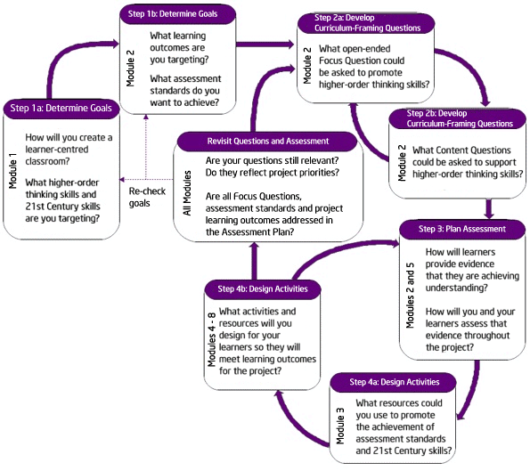

Slide 12
Examining Good Instructional Design
Module 1: Teaching with Projects - Activity 3
Move into teams of 2
  Foundation Phase
  Intermediate Phase
  Senior Phase
Investigate projects online
Use Projects characteristics checklist handout
Notes:
Not all units of work need to incorporate project approaches to learning, but when appropriate, the integration of a project can greatly enhance learner learning. Some units of work are project-based from start to finish, while other units only incorporate a project as a culminating experience or in one part of the project.

Slide 13
Targeting 21st Century Skills
While working on projects, learners develop real-world, 21st Century skills—many of the same skills desired by today's employers—such as the ability to:
  Work well with others
  Make thoughtful decisions
  Take initiative
  Solve complex problems
  Self-manage
  Communicate effectively

Slide 14
3. Assessing Projects
Module 2:
Considering Multiple Methods of Assessment - Activity 3
Include assessment for five purposes:
  Formative Assessment
    Gauging Learner Needs
    Encouraging self-direction and collaboration
    Monitoring progress
    Checking for understanding and encouraging meta-cognition
  Summative Assessment
    Demonstrating understanding and skill

Slide 15
Assessment Timeline
Before project work begins | Learners work on projects and complete tasks | After project work is completed
Questioning Journals Project Plan KWL Chart | Written summaries Observation checklist Journals Questioning Group and self-assessment Project Rubric Meetings | Newspaper Rubric KWL Chart Mock Trial Reflective Essay

Slide 16
Assessments
Read about Assessment Strategies at Assessing Projects. Under Try it use the Demo, Tutorial and View the animation .
The different assessment strategies each achieve a purpose, think about how you can use the methods in your projects back at school.
As you consider assessment strategies for a project, brainstorm answers (in pairs) for the following questions:
  What is the purpose of an assessment?
  What methods are appropriate to meet the purpose?
  What instrument is most effective?
  When do I use the methods and instruments?
  What do I do with the results?

Slide 17
4. Legal and Ethical Practice related to ICT use
Module 3:
Modeling and Teaching Legal and Ethical Practice Related to ICT Use - Activity 2
Exploring Copyright
Take the copyright quiz.

Slide 18
5. Planning for Learner Success
Module 6: Planning for Learner Success - Activity 1
Creating Accommodations for All Learners
Considering Different Learning Modalities
Break into groups of 3 and assign each group member to report one of the following frameworks:
  Visual-auditory-kinesthetic
  Left brain/right brain
  Multiple intelligences
Click on Thinking Skills Frameworks > Learning Styles
Discuss how these different ways of looking at learning styles could have an impact on a project.
Notes:
Meeting the needs of all learners requires careful preparation and planning in project design. All learners need the right amount of scaffolding so that they feel confident and comfortable taking risks, and are working to become independent learners. Learners with learning difficulties, non-first language speakers, and learners with exceptional abilities need different kinds of support.

Slide 19
6. Facilitating with Success
Module 7:
Additional Resources - Activity 1
1. Considering DoE Guidelines
2. The Facilitation Examples
Sample presentations, publications, wikis, and blogs for teacher and classroom use.
3. Creating Facilitation Materials
Online Resources

Slide 20
Interested?
Do you know how ICT can be used most effectively to support and assess learning?

Slide 21
Questions?
Intel Teach programs: http://www.schoolnet.org.za/ttf/index.htm
Intel Project Coordinator - Dezlin Jacobs
  office: 011 403 5777
  fax : 086 517 4808
  email: dezlin@schoolnet.org.za

