Slide 1

Notes:
3

Slide 2

Title of Presentation: Introduction to ThinkQuest Projects.
  By Claire Dean, Head of ICT, Stirling Primary, East London, Eastern Cape
  Senior Trainer: SchoolNet SA
  Approved Facilitator: Oracle Education Foundation

Slide 3
Oracle Education Foundation
Independent charitable organization funded by Oracle
Dedicated to helping Grade 1-12 students develop 21st Century skills
Provides ThinkQuest as a free service to primary and secondary schools
  548 000+ students/teachers in 47 countries
  More than 10 000 entries into the new International ThinkQuest competition
  Thinkquest Library: Visited by more than 58 million learners annually, an award-winning learning resource which features more than 8,000 educational websites.
Notes:
OEF was founded in 2002
OEF is a 501(c)(3) nonprofit

Slide 4
ThinkQuest
Protected, online learning platform
Enables teachers to integrate learning projects into curriculum and students to develop 21st century skills
Includes:
  Project environment
  Competition space
  ThinkQuest Library
  Professional development
Notes:
Project environment: where teachers and students engage in collaborative learning
Competition space: where students participate in technology contests
ThinkQuest Library: an award-winning learning resource visited by millions
Professional development: program for educators

Slide 5

Base Content Slide
Think Together
Think.com is now part of ThinkQuest.

Slide 6
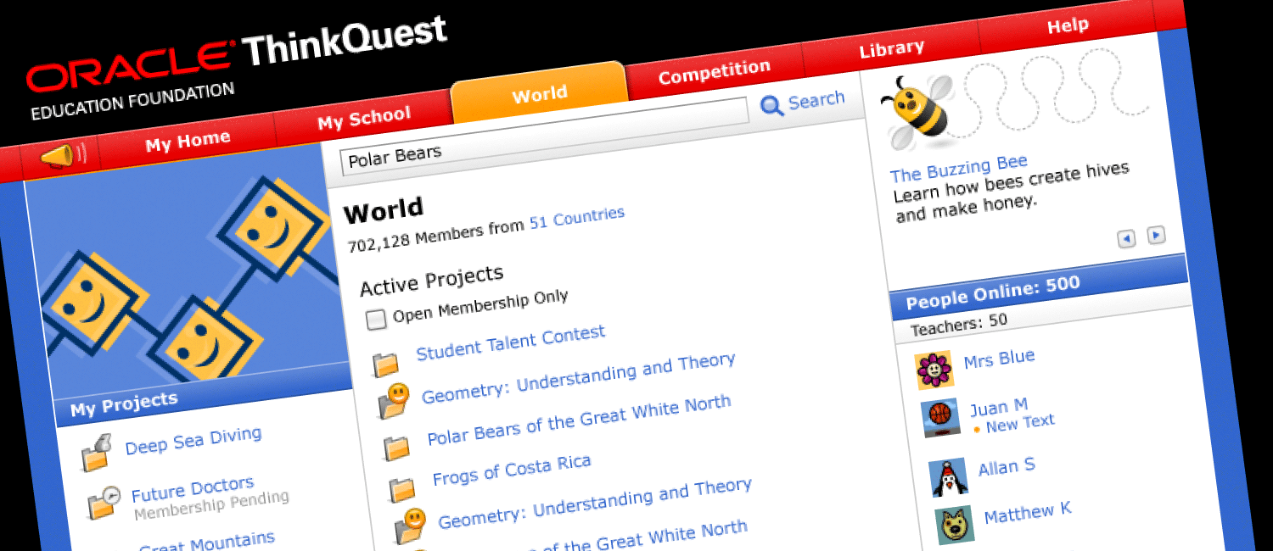
Base Content Slide
Base Content Slide
First-level bullet
  Second-level bullet
    Third-level bullet
      Fourth-level bullet
        Fifth-level bullet
Learning Projects
Integrate learning projects into your classroom curriculum. Choose a topic, assign students, invite teachers, and collaborate with members around the world.

Slide 7

Base Content Slide
First-level bullet
  Second-level bullet
    Third-level bullet
      Fourth-level bullet
        Fifth-level bullet
Pages
Projects come to life when students create pages with text, pictures, multimedia, votes, brainstorms, debates, and messages.

Slide 8

Base Content Slide
Base Content Slide
First-level bullet
  Second-level bullet
    Third-level bullet
      Fourth-level bullet
        Fifth-level bullet
Competition
A space for students to participate in technology contests. All eligible entries are published in the ThinkQuest Library.

Slide 9

ThinkQuest Competition
Challenging Students Globally to Think, Create, and Innovate
This exciting competition challenges students to apply their critical thinking, communication, and technology skills to a real-world problem. Teams research, develop, and test their solution before presenting it to a global audience.

Slide 10
ThinkQuest Competition
ThinkQuest Projects
  Teams present their solution by creating a project in ThinkQuest Projects, an online learning environment.
    Age Divisions
      19 and under
      16 and under
      12 and under

Slide 11
ThinkQuest Competition
Digital Media
  Teams present their solution by creating a blog/journal, website, animation, public service announcement, photo essay, video, or some combination of these items.
    Age Divisions
        19 and under
        16 and under
        12 and under

Slide 12
ThinkQuest Competition
Application development
  Age Divisions
    22 and under
    19 and under
    16 and under
Teams develop a web-based application or game that solves a problem.

Slide 13

Base Content Slide
Base Content Slide
First-level bullet
  Second-level bullet
    Third-level bullet
      Fourth-level bullet
        Fifth-level bullet
Library
This award-winning resource contains 7,000+ projects and offers students the opportunity to have their work published and seen by millions.
Notes:
Library: (The) ThinkQuest Library the world’s largest online repository of student-developed learning projects. It is visited by millions of web learners each month.

Slide 14

Titles of the 2009 winning teams:
Website competition
  LEAD Portal – Bringing out the Leader in YOU! [Singapore, Australia, China ]
  Chocolate [Hungary]
  S.O.S. Save Our Species [United States]
Narrative competition
  Planet Keepers: Protecting Our World United as One [Puerto Rico]
  Let's Rock and Roll United States, Brazil, India
  Tour of a Life time [South Africa]

Slide 15
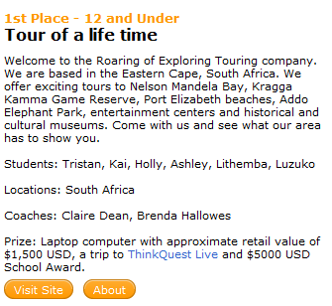

Slide 16

Base Content Slide
First-level bullet
  Second-level bullet
    Third-level bullet
      Fourth-level bullet
        Fifth-level bullet
Benefits
Develop 21st century skills such as critical thinking, teamwork, communication, creativity, technology, self-direction, and cross-cultural understanding
Professional Development
A comprehensive training offering for educators to support 21st Century Learning in the classroom.
Notes:
Professional Development: ThinkQuest Professional Development is a comprehensive training offering for educators. It includes an instructor-led seminar that introduces ThinkQuest Projects to new users; a self-paced tutorial that shows ThinkQuest Competition participants how to be successful; and a Project Learning Institute that train teachers how to integrate technology, project learning, and 21st skills development into their classroom curriculum.
Project Learning Institute: The Project Learning Institute trains teachers how to integrate technology, project learning, and 21st skills development into their classroom curriculum.

Slide 17

Base Content Slide
First-level bullet
  Second-level bullet
    Third-level bullet
      Fourth-level bullet
        Fifth-level bullet
Protected and Free
The Oracle Education Foundation offers primary and high schools a safe environment at no cost. ThinkQuest is password protected, teacher monitored, and includes no advertising.

Slide 18

Base Content Slide
First-level bullet
  Second-level bullet
    Third-level bullet
      Fourth-level bullet
        Fifth-level bullet
Steps to Enroll:
1. A teacher or school administrator completes the online application.
2. We review the application and verify that the school is accredited.
3. The school is now ready to create projects or join the competition.

Slide 19
Participate in a ThinkQuest Project
Log in to ThinkQuest with username and password provided
Change your password
View the National Geographic “Ocean Now” project
  Timeline: September 15 - October 15, 2009.
  Members: 2535
Explore the different tabs:
  Home
  School
  World
  Competition
  Library
Notes:
A ThinkQuest Project can be used with a very small teams, a class, grade or between numerous countries.
Even though the Oceans Now project has ended, teachers can use this project's activities and layout as a template for their own projects.

Slide 20
Workshop - continued
Click on My School > Workshop Activities
Activity 1: Meet and Greet
Activity 2: What and Why?
Activity 3: The Expedition
Activity 4: Community Service
Activity 5: Turtle tales
Activity 6: Journals
Notes:
The Project Title in ThinkQuest for the workshop is “Workshop Activities”

Slide 21
Workshop - continued
Questions
  Use the Ask Me tool to ask Presenter any questions.
Send a message to Members
Role of the Help tool
Notes:
Not all the tools will be covered during the workshop due to time constraints

Slide 22
Base Content Slide
QUESTIONS?
Contact Sonja Balt for more information in SA at:
sonja.balt@oracle.com
Notes:
24

