Slide 1
Assessing Projects
The Intel Assessment Application

Slide 2
Assessment in 21st century Classrooms
Things have changed!
Assessment used to mean tests, quizzes and exams
But imagine trying to assess learners’ collaboration skills using a test
With teachers’ changing practices, assessment practices must be broadened in order not only to assess content but also to assess skills

Slide 3
Assessment of Content
Assessment of Projects
Continuous assessment – giving feedback DURING the project
Embedded in daily instruction to inform the teaching and learning process

Slide 4
Formative assessment provides learners with feedback about how they are doing throughout the learning process. Summative assessment takes place at the end of a unit or project and gives students and teachers information about the skills and knowledge that students have acquired.

Slide 5
Formative Assessments
Gauge students' prior knowledge and readiness
Encourage self-direction and collaboration
Provide diagnostic feedback to teacher and student
Monitor progress
Check for understanding and encourage metacognition
Demonstrate understanding and skill

Slide 6
Collaboration Assessment
Creativity Assessment
Problem Solving
Self Direction

Slide 7
Summative Assessments
Summative Assessment
While formative assessments can give students and teachers information about how well they are doing while they are working on projects, at some point, most teachers are required to give a report on student learning at the end of a particular unit or on a particular project. Students also want and need to know how well they have done. This kind of assessment, done after the fact, is called summative assessment.
Summative assessments, like unit tests, can provide useful information if teachers and students take the time to look at them analytically. Teachers can find areas of weakness to address in more depth in future units and with future groups of students. Students can identify problem areas and set goals for future learning.

Slide 8
Demonstrate SKILLS at the end of the Project
PRODUCTS and PERFORMANCES

Slide 9
Purposes of Assessment
“When assessment is integrated with instruction, it informs teachers about what activities and assignments will be most useful, what level of teaching is most appropriate, and how summative assessments provide diagnostic information.”
all kinds of methods and strategies that provide information about a student’s learning.

Slide 10
The Intel Assessment Tool
Find it here:
www.intel.com/education
For K-12 educators
Assessing Projects

Slide 11
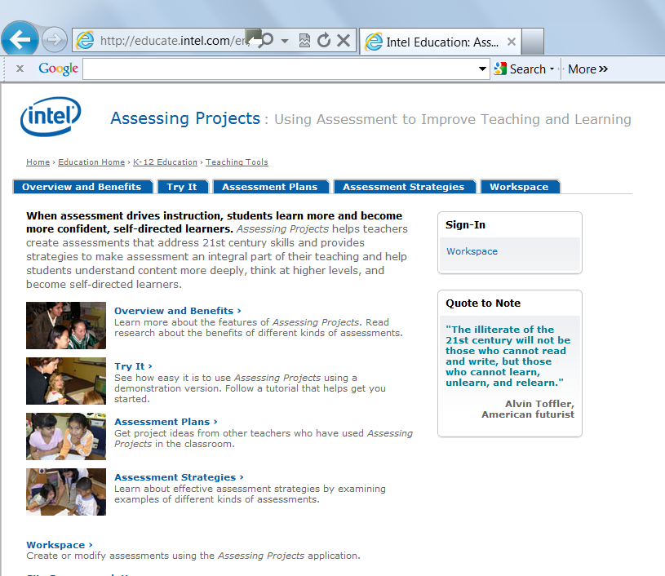

Slide 12
A brief look at it
The Demo
http://download.intel.com/education/common/en/resources/AP/demos/AP_overview_demo/AP_overview_demo.htm

Slide 13
Steps to working with the Tool
Browse Assessments
Search Assessments
Modify Assessments
Copy traits from other Assessments
Create an Assessment from Scratch
Manage your Personal Library
Export Assessments

Slide 14
Libraries
Personal Library
  Your own tools that you have saved, modified or created
Assessment Library
  A large number of tools that have been created and from which you can select tools that you like

Slide 15
Now do it!
Sign in to the WORKSPACE
  If you have not yet worked with the Intel tools you will need to REGISTER first but this will take you straight into the workspace – no delay
OR
Use my login
  snsaconference
  conference

Slide 16
The Project Scenario
Imagine you have created a project on EXTREME SPORTS
The class brainstorms a list of Extreme Sports and uses a Ranking List to put them in order from MOST extreme to LEAST extreme
A question is posed “Does Extreme Sport = Extreme Madness?”

Slide 17
Learners work in groups to research a different sport per group
  Interviews, internet research, print media, videos and movies, etc
They record their data in a WIKI
  Group members divide the questions amongst themselves and comment on one anothers’ research

Slide 18
They answer the Focus Question (targeting Higher Order Thinking) in an essay format
  Individual assessment
They develop their own Extreme Sport in their groups
  Given some basic materials, they design a sport and then do it
  Develop safety regulations and a “how to” chart

Slide 19
Develop Assessment Tools
BEFORE
  Assessment to GAUGE NEEDS
DURING
  Group Collaboration
  Wiki Checklist
AFTER
  Assessment of Essay
  Assessment of Performance

Slide 20
Select one or more Assessments to create and then follow the steps
BROWSE
SEARCH
MODIFY
SAVE

Slide 21
Learn More
Do the Tutorial under TRY IT
Watch the WEBINAR on Assessing Projects

