Slide 1
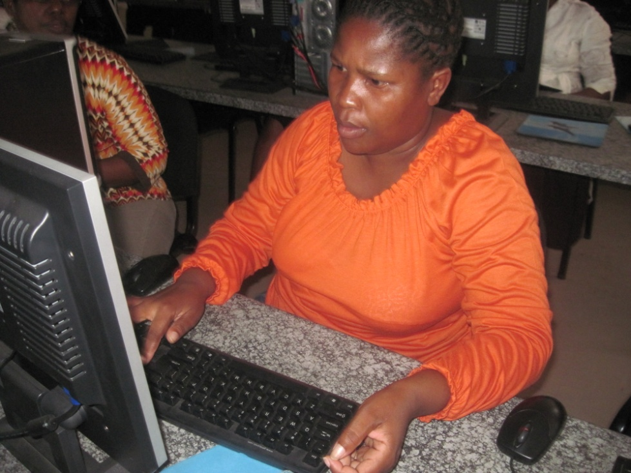

Nomty Gcaba
SCHOOLNET SA CONFERENCE - 2011

Slide 2
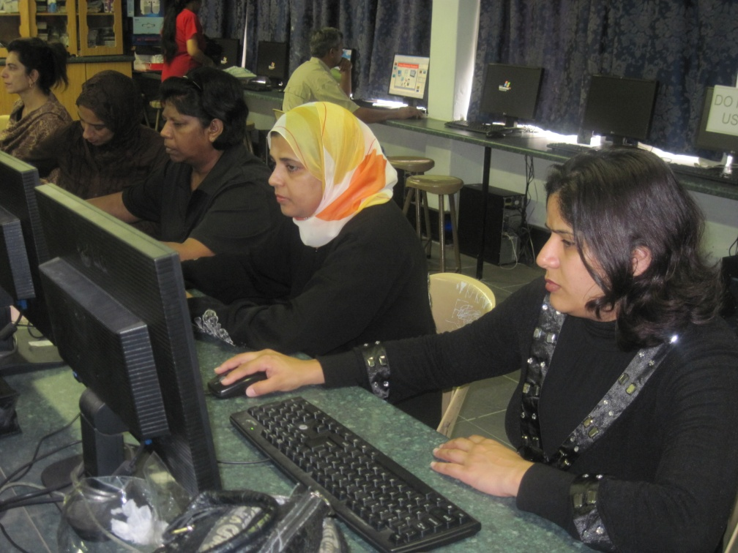
Partners in Learning
One Step Further

Slide 3
Course Overview
One Step further training take place after Partners Learning or Getting started.
Duration of 24 hrs training – 3 days
20-25 Teachers in the school or the cluster.
Ideally participants should be computer literate.

Slide 4
Software Requirements:
This course is designed in Microsoft* One Note.
  Microsoft* One Note is included in the SA Schools Agreement Software.
Microsoft Encarta and or Internet if available.
Microsoft Partners in Learning CD for training purposes.
It focuses on working with information and what to do with it in simple, yet pedagogically sound ways.

Slide 5
Course Outcomes
Grow teachers’ confidence with ICT
Develop basic information literacy skills using Microsoft* Encarta
Develop learning objects using a range of resources
Evaluate Microsoft* One Note as an educational tool
Evaluate Microsoft* Encarta as an information source
Introduce mathematics and science teachers to simple resources

Slide 6
The course consists of 4 modules namely:
Information Gathering
Simple Research
Learning Objects
Maths and Science

Slide 7
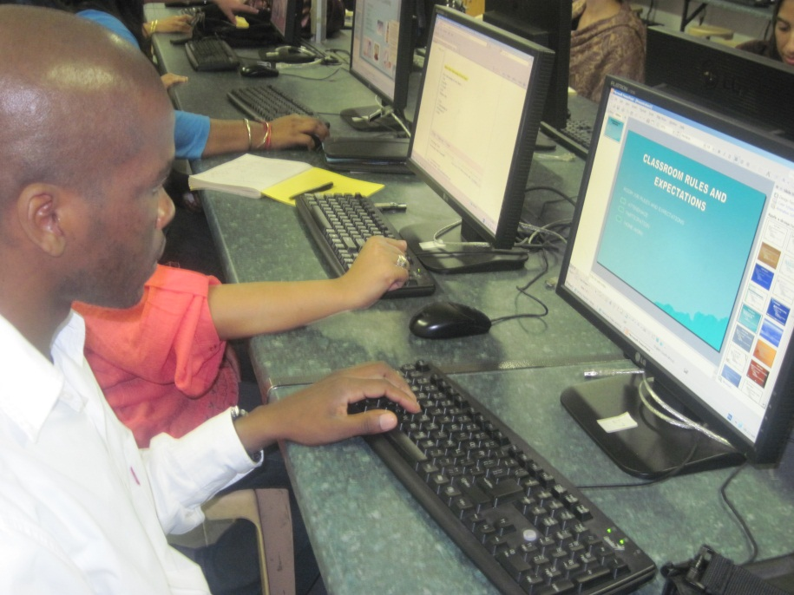
Information Gathering
Using One Note answer the following question:
Why do you ask learners to gather information?

Slide 8
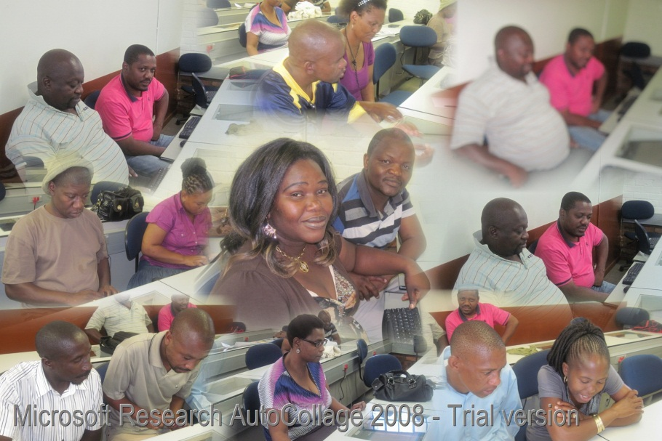
Open Notebook
Start
All programs
Microsoft office Note 2010
File
Open
Open Notebook
Desktop
Microsoft partners in learning/open
One Step /open
One step further
Open

Slide 9
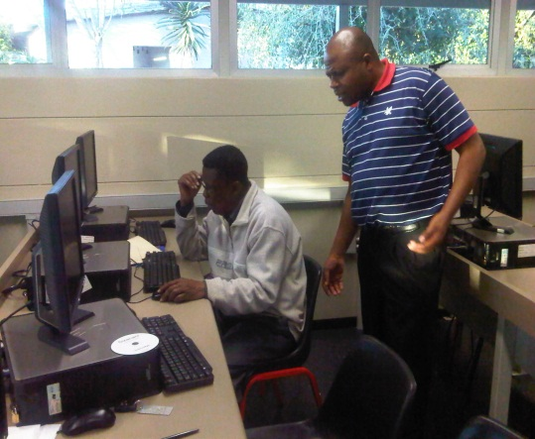
Possible answers
stimulate their interest
form an opinion
think about the topic
suggest ways of overcoming a challenge
observe the characteristics of something
create something from the gathered artefacts
Make decisions
understand something before moving on to a more complex topic

Slide 10
Tips on Gathering information
Purpose of information
Accuracy
  References, sources, links & information.
Credibility
  Author & Experience
Bias

Slide 11
Simple Research
Authentic and Engaging Tasks
Real-life
Complex in nature, not solved easily.
Open-ended, not leading to one "right" answer
Short and punchy, not a paragraph

Slide 12
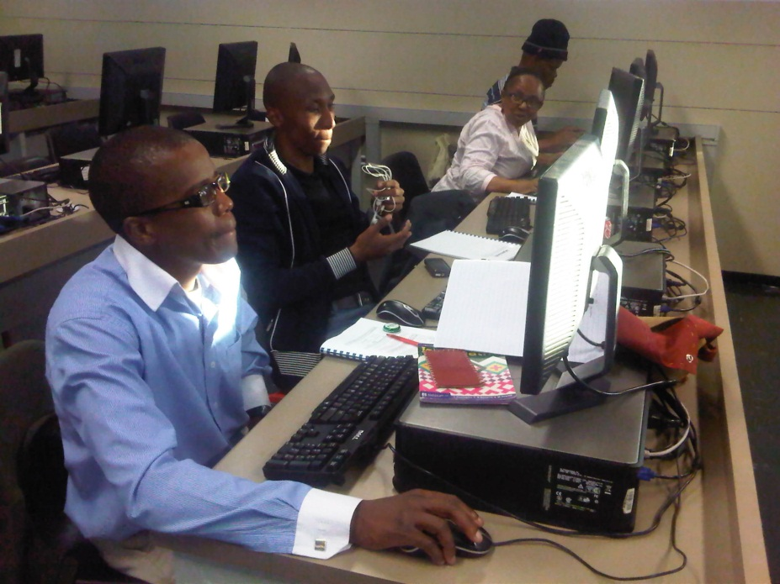
My Challenging question
“Should I think twice before I text while driving”

Slide 13
Texting while driving
Sample of the finished project
Video
video

Slide 14
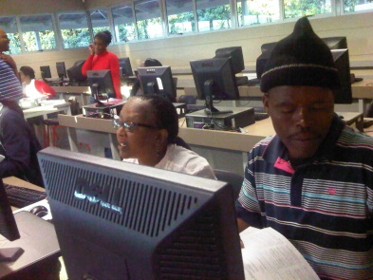
Samples of Challenging Questions
Can famine be prevented?
Should the state relieve famine?
Is famine just a relative concept? Must all things repeat in nature?
Does our use of waves make our lives better?
Does a trend affect people’s choices?
Can photographs help us to interpret the past?
Did empires improve daily life in the ancient world?

Slide 15
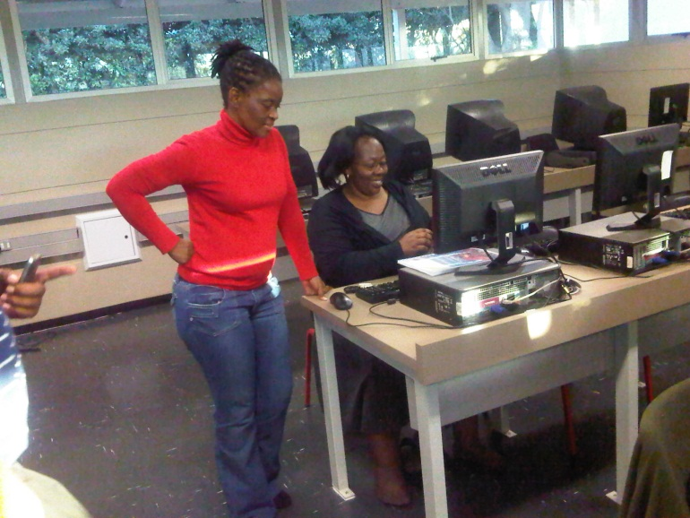
Challenge
Design your own Challenge Question using Microsoft One Note on a new page.
PARTICIPANTS THEN DEFEND THEIR PROJECT AND THEN DO THE RESEARCH IN ENCARTA AND INTERNET.

Slide 16

Other courses by SchoolNet
Approaches
Intel® Teach Elements: Project-based
Microsoft® Partners in Learning: ICT Integration (Web Quests)
Intel® Teach Essentials (Designing Effective Projects)
Intel® Teach Thinking with Technology
ACE module: Working with Information (distance learning)
ACE module: Learning with Projects (distance learning

