Slide 1

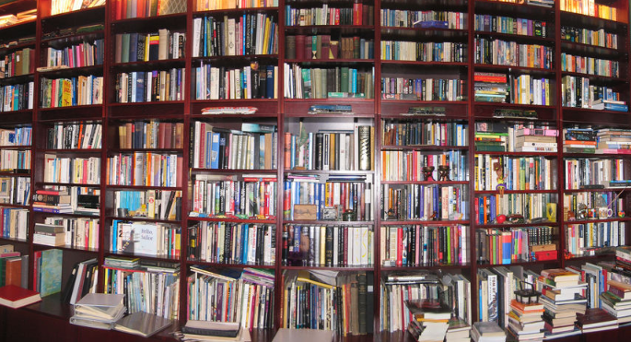
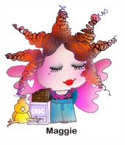
Creating a 1-Click
Digital Library Mash-up
Schoolnetsa11 Conference
Digital library mashups
Maggie Verster
ICT4Champions
www.ict4champions.co.za
Notes:
Photo source: http://www.flickr.com/photos/gcoupe/20972113/

Slide 2
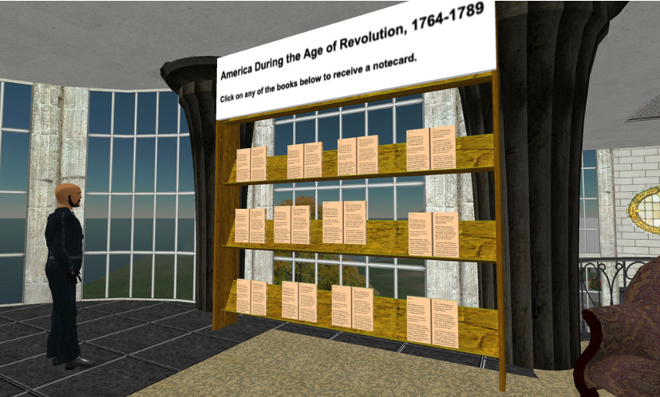
Digital library?
Electronic resources
A type of information retrieval system
Targeted search engines
Directories
A collection of literature and metadata stored electronically
Databases
E-books, PDF’s
Web pages
Videos
Graphics (photos)
Audio (recordings and podcasts)
Animations
Simulations
Other information artefacts
In the field of digital libraries, the Internet is the library (Arms, 2001)
Notes:
http://www.flickr.com/photos/pathfinderlinden/227332249/sizes/l/in/photostream/
[twitter] In the field of digital libraries, the Internet is the library (Arms, 2001)[/twitter]

Slide 3
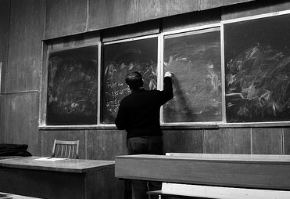
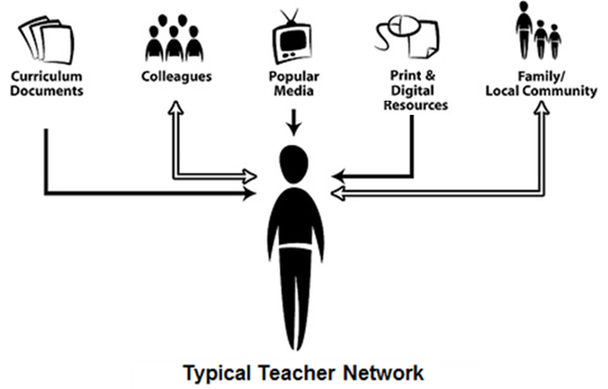
Teacher 1.0
Source: Courosa.
Notes:
http://www.flickr.com/photos/courosa/344832659/in/set-72157615129270288/
http://www.flickr.com/photos/32530713@N08/3322829633/
[twitter] What does a typical teacher network look like? [/twitter]

Slide 4
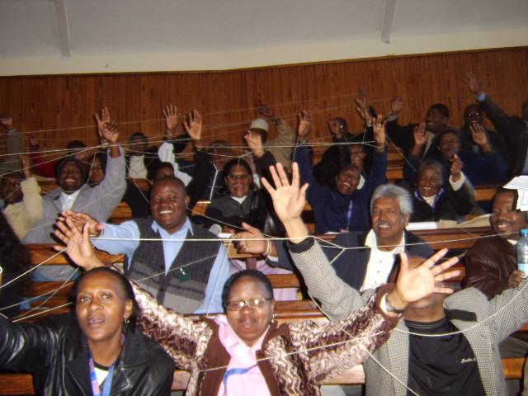
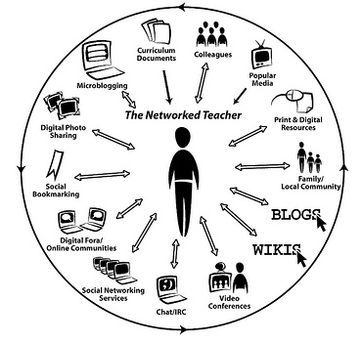
Teacher 2.0
Adapted from @Courosa.
Notes:
[twitter]Are u a connected teacher? Mmmmm http://bitly.com/kIzgPV [/twitter]

Slide 5
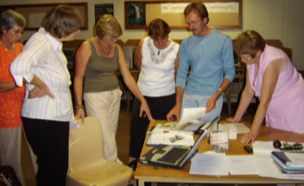
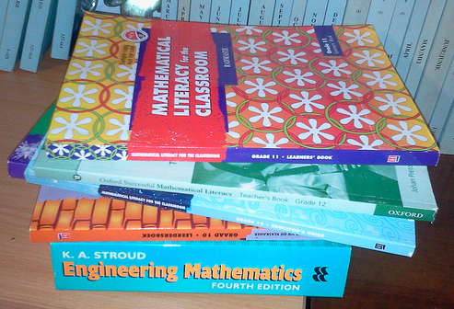
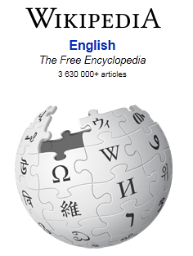
Finding stuff?
Notes:
[twitter] Which tools do u use to find stuff to use in your class/on the internet? [/twitter]

Slide 6
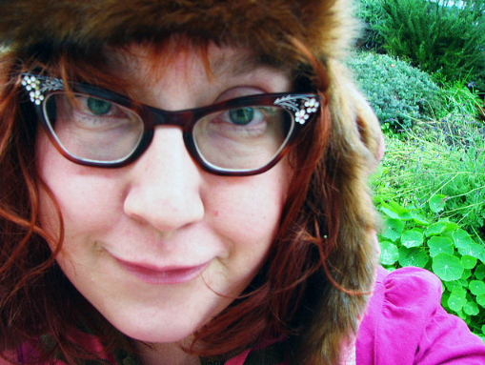
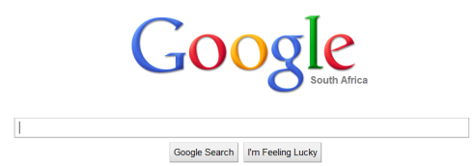
Finding stuff?
I am desperately looking for my glasses.
Notes:
Photo source: http://www.flickr.com/photos/jek-a-go-go/4335817438/
[twitter] See my list of google power search articles: http://bitly.com/jEADex?r=bb [/twitter]

Slide 7
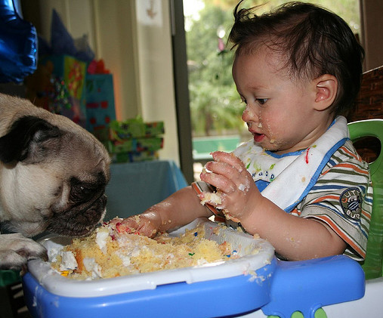
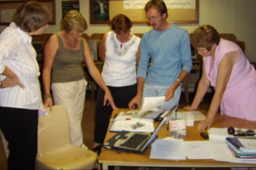


Sharing stuff?
Very Messy
Very Old
Mostly inconsiderate
Dangerous
Notes:
Photos sources:
http://www.flickr.com/photos/efleming/237379252/
Maths literacy teachers’ community www.mathsliteracy.co.za

Slide 8
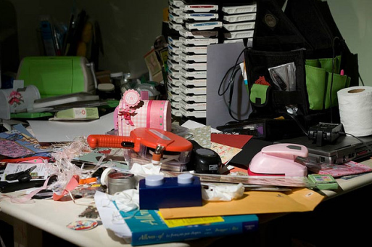



Storing stuff?
Very Messy
Very Old
Can disappear….
Dangerous
Notes:
Photos sources: http://www.flickr.com/photos/camknows/3821001012/

Slide 9
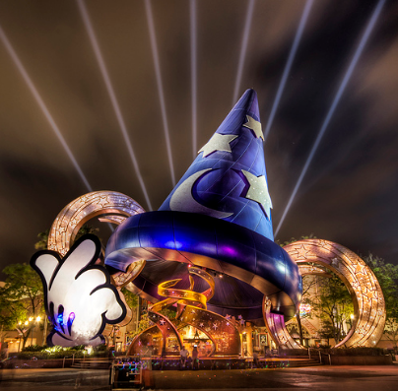



Tools?
My DL wish list
Relevant
Easy to use
Searchable
Portable
Scalable
Tagable
Collaboration and discussion
Aggregation (RSS)
Embeddable
Annotation
Citation
Personal /Professional organiser
Free
Social
Bookmarking
Notes:
http://www.flickr.com/photos/stuckincustoms/459418289/
Relevant: I need to have the latest resources in any specific topic. My database therefore must show me the latest resources…
Easy to use: Duhhhh I am not a programmer- need to find thing quick!
Searchable: The point of a good database is to be searchable! I must be able to easily find things that I have stored.
Portable: I need to be able to access my resources from any computer or mobile device.
Scalable: My database must be able to grow with my interests and needs while still be able to do any of the above.
Tagable: I must be able to assign my own tags or keywords to a resource so that I can find it again (see searchable)
Collaboration and discussion: If the library allows me to collaborate and share my resources with my learning network automatically it will be a great plus. If I can also discuss each research with others to add context to a resource….
Aggregation. I would like to pull in and place my resources into my other learning platforms e.g. My website, my school blog/site/learning management system.
Embeddable: This means that even though the resource is in the database library, a list or keyword cloud can be generated so that I can embed it in other places where it will be updated automatically as I add to my database.
Annotation: Wouldn’t it be great if I could leave messages and notes on my resources as reminders to myself and for discussion by others?
Citation: Not only do I want my database to remember where on the internet it found the resource, I would also like an automatic citation reference to be created.
Free: I am a teacher- I do not have money…☹

Slide 10
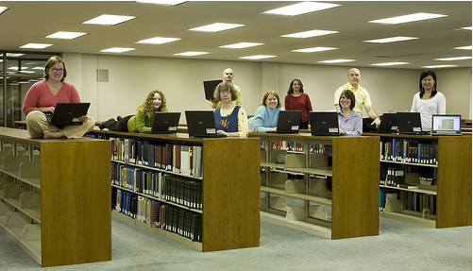
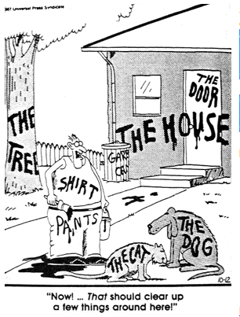
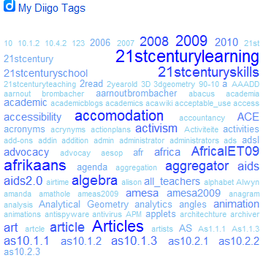
Social bookmarking?
Digital libraries:
Project Gutenberg
Google Scholar
Zotero, Mendeley, Mekentosj Papers, MyNCBI, CiteULike, Connotea, and HubMed
Social bookmarking:
→Finding resources
→Metadata
→Saving
→Database
→Search & Sharing
→Discussion
No physical boundary. The user of a digital library need not to go to the library physically; people from all over the world can gain access to the same information, as long as an Internet connection is available.
Round the clock availability. A major advantage of digital libraries is that people can gain access to the information at any time, night or day.
Multiple access. The same resources can be used simultaneously by a number of institutions and patrons. This may not be the case for copyrighted material: a library may have a license for "lending out" only one copy at a time; this is achieved with a system of digital rights management where a resource can become inaccessible after expiration of the lending period or after the lender chooses to make it inaccessible (equivalent to returning the resource).
Information retrieval. The user is able to use any search term (word, phrase, title, name, subject) to search the entire collection. Digital libraries can provide very user-friendly interfaces, giving clickable access to its resources.
Preservation and conservation. Digitization is not a long-term preservation solution for physical collections, but does succeed in providing access copies for materials that would otherwise fall to degradation from repeated use. Digitized collections and born-digital objects pose many preservation and conservation concerns that analog materials do not. Please see the following "Problems" section of this page for examples.
Space. Whereas traditional libraries are limited by storage space, digital libraries have the potential to store much more information, simply because digital information requires very little physical space to contain them and media storage technologies are more affordable than ever before.
Added value.
One
click
Notes:
Photo source: http://www.flickr.com/photos/trucolorsfly/1731439493/
Social bookmarking is like having a whole library of expert a collaborative way to collect and manage resources. It is characterised by being able to tag (assign keywords) to a resource as well as other metadata (descriptions) in order to find it again later. The resources and their metadata and where they can be found on the internet are then stored in a powerful database which makes detailed searching possible, not only for your own purposes but for your learning network as well. You can then have discussions or comment on resources share d by your network. This in effect means that we can learn over each others shoulders.

Slide 11

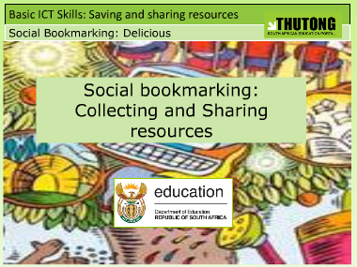

How?
Notes:
http://www.flickr.com/photos/thomashawk/176219371/
Diigo video: http://vimeo.com/12687333

Slide 12
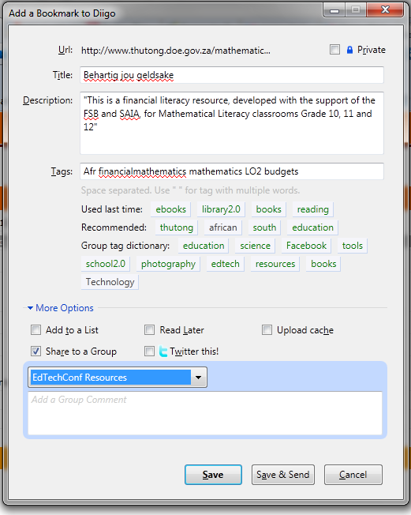
Auto-insert the Url and Title
Auto-insert a description or insert your own
Add the relevant tags
Send to group /list
Tweet!!!
One
click
Notes:
[twitter] All the resources are captured with one click from your browser toolbar [/twitter] ! You will also be able to see if the resource was bookmarked previously as the little book icon will show red.
You will see if the resource was bookmarked to one of your resource groups already. You can also insert a comment about the resource for your group purposes.

Slide 13
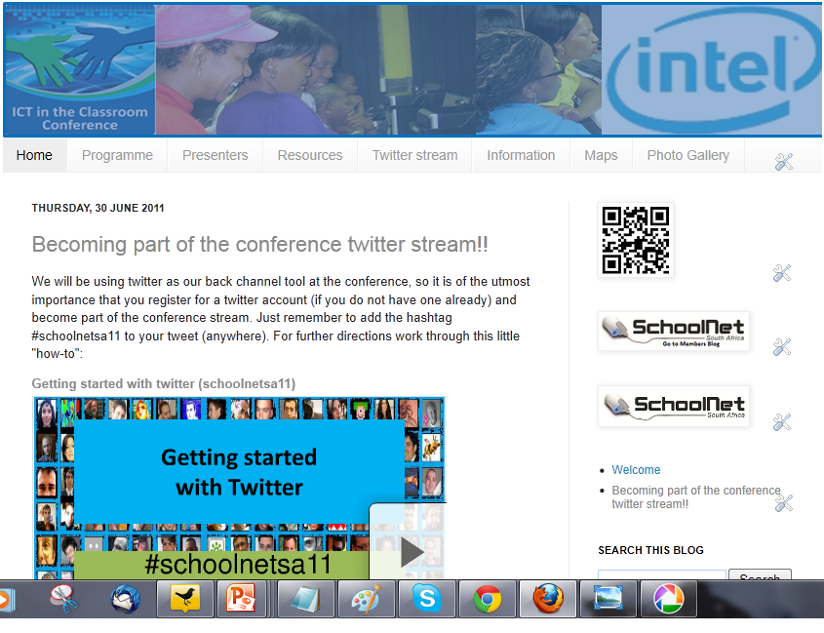

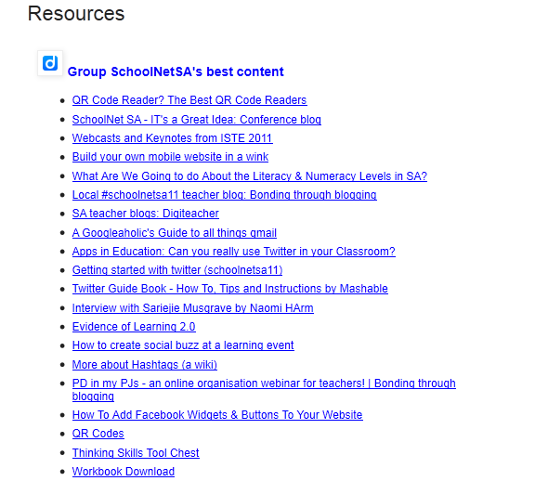
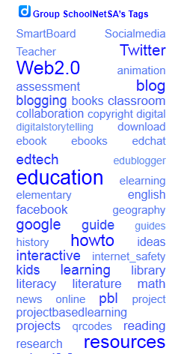
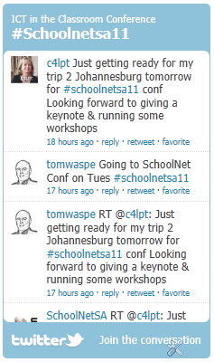

Slide 14

DL Framework
One
click
Diigo
Bookmarking database
Auto
Blog Post
E-mail newsletter
Resource
Discussions
RSS Feed
Widget
Social network
LMS
CMS
Blog
Wiki
Website
Annotations
Resource
Metadata
Tag cloud widget
Groups
Resource
Lists
Tweet
Networks
Notes:
http://www.flickr.com/photos/darwinbell/395970515/
This is a framework of how a digital library in Diigo can be propagated across all your platforms. You start with finding the resource. Click on the Diigo addon in your browser where you can add specific tags and a description to your resource (metadata). You can also at this point choose to send the resource to specific groups or even send it to a list that you can order further as well fine-tune later (e.g. reading list). As Diigo allows you to create networks of people with similar interests, their resources will show up in your network space and yours in theirs. This allows you to keep track of resources that you might have otherwise missed. You can also annotate and leave messages and notes on webpages. Once a resource have been bookmarked, your network can then discuss each resource or add comments.
The next level of the framework depends on Diigo’s ability to aggregate data. The first automatic feaure that I can set up is to tell Diigo to create an automated daily or weekly blogposts of resources tagged with a specific keyword e.g. mathematics. All the followers of my mathematics blog can then go and read the resource list on my mathematics blog and if they have subscribed to my blog they will even receive it as an e-mail.
RSS widgets are pieces of code that I can embed practically on any online platform (blogs, websites, school moodle sites , LMS, CMS, Wiki etc). It creates a tag cloud or resource list (link-roll) which will auto update no matter where I embedded it, every single time I add a 1-click resource!
Lastly, every time I bookmark a resource (1click)→ I can choose to also send out a tweet. So if my teachers are following the tweet handle, they will instantly know that a resource have been bookmarked, making it the ideal communication system.

Slide 15










Let’s create a Mashup!!
Creating a social media framework for the ICT in the Classroom conference
Notes:
http://www.flickr.com/photos/ishkamina/3164626835/
[twitter]The whole social media framework is driven by our digital library (diigo) [/twitter]
To demonstrate how a integrated digital library will serve an educational context my first case is the social media framework for the Schoolnetsa11 conference. I wanted to create a workable framework that is easy and fun to maintain and which will create a buzz for the conference. It has to share resources across twitter, have a place where it can be stored and tagged and be channelled to facebook and the conference blog.

Slide 16





Let’s create a Mashup!!
Posts/updates
Tweet Post
Embed
Manually upload/
code
Daily Post
Blog
Twitter
FB
Every blog post
Slideshare
Every blog post
Dropbox
Notes:
[twitter] All my mashup diagrams are dedicated to @love_da see http://bit.ly/kkZjpf [/twitter]

Slide 17
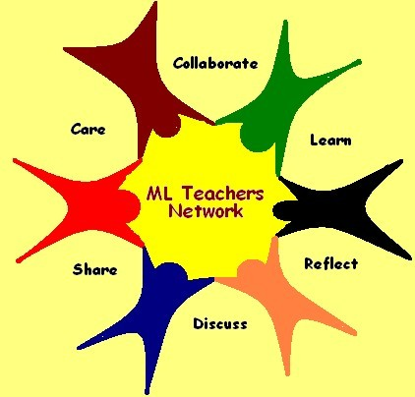
Case study 2
The context and the learning goals must dictate the tool and how it is used
Case study
Maths literacy teachers community of practice
www.mathsliteracy.co.za
Maths lit blog
Digital library database
Twitter
Notes:
http://www.flickr.com/photos/ishkamina/3164626835/
To demonstrate how a integrated digital library will serve an educational context my case study is based on my Mathematical literacy teachers community of practice. It has 4 “tools” that makes it possible to function and support the goal of doing advocacy as well as provide a platform for teachers to share and learn. The 4 tools are:
The social networking platform on NING (discussions, physical upload of resources, blogs, chats)
A advocacy blog for parents and teachers
A digital library social media database on Diigo
A twitter communications channel.

Slide 18
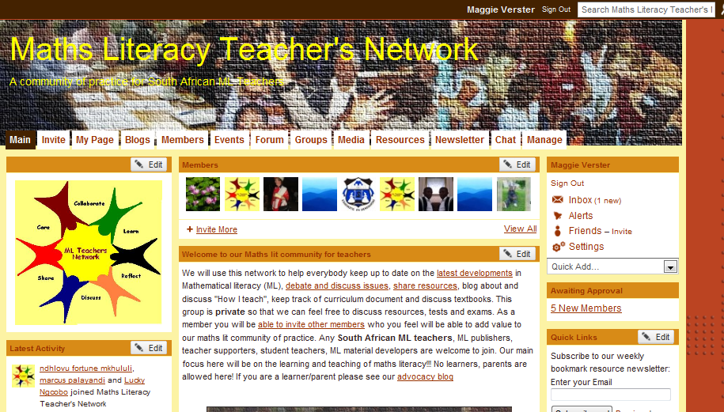
Click here to go to live site
As it is a closed community,
sign in with:
Username:
conferences@mathsliteracy.co.za
Password:
maggie123
Notes:
This is a screenshot of our mathsliteracy teachers community at www.mathsliteracy.co.za. You need to be a member to see more than the front page. As only maths lit teachers and teachers supporters can join, you can use the guest access: Username: guest@mathsliteracy.co.za Password: maggie123 to have a little peek around.

Slide 19
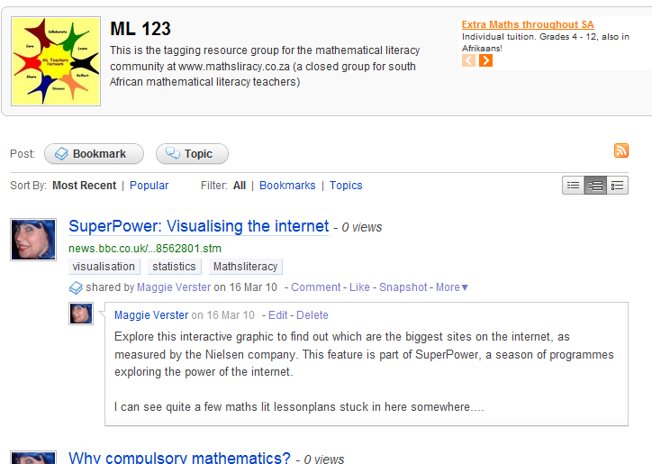
Click here to go to live site
Notes:
Our maths literacy community bookmarking group can be found here: http://groups.diigo.com/group/ml-123
Every time a teacher upload a resource, I (or 1 of the bookmarking team) tag their resource to our diigo database. All resources me and other members find on the internet relating to mathematical literacy, also get tagged along with uploaded resources. If a teacher then click on a specific resource they will be taken to the resource, either on the internet or in the Maths literacy community. This happens so seamlessly hat they are not aware that they are in fact moving between platforms the entire time!!

Slide 20
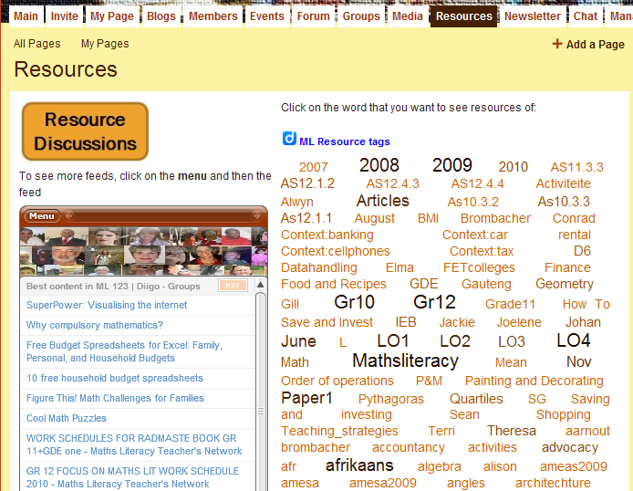
Tag
Cloud
RSS Feed
Click here to go to live site
Notes:
Even though the resource references are actually databased and bookmarked in Diigo (Using 1 click in my browser), I have embedded the tag cloud and the link roll on the Resources page in the online community. This means that every new resource added to the database is automatically updated on the resource page with very little effort. When a teacher click on the relevant topic or resource, it takes them back to the Diigo site where the resources are listed. Clicking on the resource there will in fact take them to the actual resource/discussion or page on the web.
All this happens seamlessly without teachers actually realising that they are moving between platforms.

Slide 21
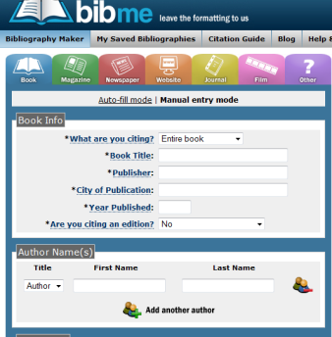
Tools?
My DL mash-up wish list
Relevant
Easy to use
Searchable
Portable
Scalable
Tagable
Collaboration and discussion
Aggregation (RSS)
Embeddable
Annotation
Citation
Personal /Professional organiser
Free
For a list of citation tools click here
Notes:
Picture source: http://www.flickr.com/photos/stuckincustoms/459418289/
Diigo fulfils almost all the criteria in my DL wish list except for citation for which there are a number of great online resources (see Zotero on next slide) and click on the picture for my diigo collected tag for citation.

Slide 22
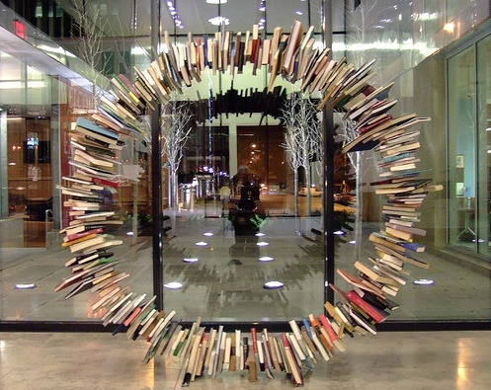
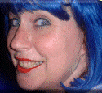
Maggie’s DL
My twitter-verse
Bookmarks on
  Diigo
    Schoo
  Delicious
School 2.0 in South Africa
SA school libraries blog
Maths literacy teachers network
Maths literacy blog
Maths blog
My presentations
Maggie Verster
ICT4Champions
maggie@maggie.co.za
www.maggie.co.za
www.school2.co.za
www.ict4champions.co.za
Notes:
http://www.flickr.com/photos/76479985@N00/102849109
Please join my Facebook page were you will be notified every time I upload a new learning object or of any online free un-workshops that I will facilitate in the future. Go to http://www.ict.4champions.co.za and like the page.

Slide 23

Photo Credits
Slide1: http://www.flickr.com/photos/gcoupe/20972113/
Slide 2: http://www.flickr.com/photos/pathfinderlinden/227332249/sizes/l/in/photostream/
Slide 3: http://www.flickr.com/photos/courosa/344832659/in/set-72157615129270288/
Slide 6: http://www.flickr.com/photos/jek-a-go-go/4335817438/
Slide 7: http://www.flickr.com/photos/efleming/237379252/
Slide 8: http://www.flickr.com/photos/camknows/3821001012/
Slide 9: http://www.flickr.com/photos/stuckincustoms/459418289/
Slide 10: http://www.flickr.com/photos/trucolorsfly/1731439493/
Slide 11: http://www.flickr.com/photos/thomashawk/176219371/
Slide 14: http://www.flickr.com/photos/darwinbell/395970515/
Slide 15: http://www.flickr.com/photos/ishkamina/3164626835/
Slide 21: http://www.flickr.com/photos/stuckincustoms/459418289/
Slide 22: http://www.flickr.com/photos/76479985@N00/102849109
Slide 23: http://www.flickr.com/photos/thomashawk/176219371/
All clipart was retrieved from www.openclipart.org and teacher photos were taken by me.
Notes:
Picture source: http://www.flickr.com/photos/thomashawk/176219371/

