Slide 1
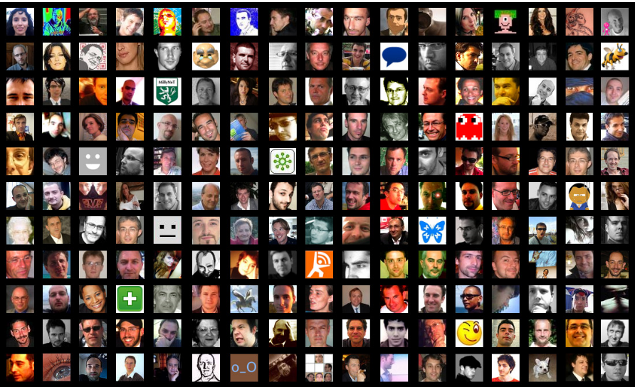
How do you become part of the #schoolnetsa conference stream?
#schoolnetsa11
Notes:
[twitter] How do you become part of the #schoolnetsa11 twitter stream?[/twitter]

Slide 2
www.twitter.com m.twitter.com
Register for a twitter account at
Notes:
[twitter] You can even access twitter on your wap enabled cellphone at m.twitter.com [/twitter]

Slide 3
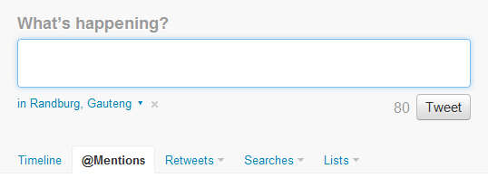
Please introduce yourself and where you are from #schoolnetsa11
Don’t forget to insert the hashtag #schoolnetsa11 anywhere in your tweet
Notes:
[twitter] Please introduce yourself and where you are from #schoolnetsa11 [/twitter]
[twitter]You will see your twitter tweet window when you click on Home at the top[/twitter]
[twitter]Just start typing your tweet into the dialogue box and add #schoolnetsa11 anywhere so that we can track it [/twitter]

Slide 4
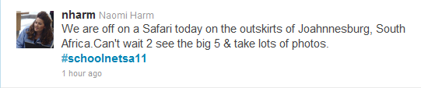
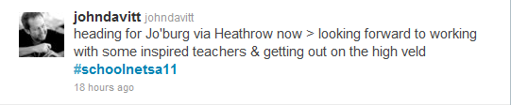

#Schoolnetsa11
Search for #schoolnetsa11
Notes:
[twitter] Search for #schoolnetsa11 in the dialogue box next to the twitter icon at the top[/twitter]

Slide 5
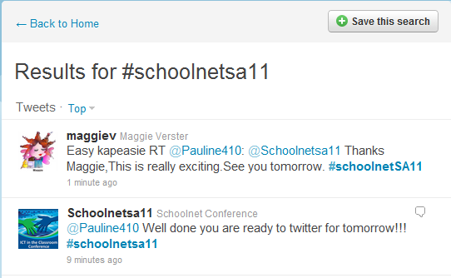
#Schoolnetsa11
Save your #schoolnetsa11
search!!
Notes:
[twitter] Search for #schoolnetsa11 in the dialogue box next to the twitter icon at the top[/twitter]

Slide 6
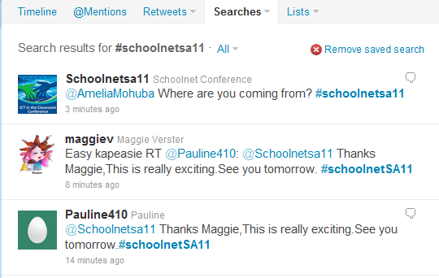

Find your saved #schoolnetsa11
search!!
Notes:
[twitter]to return to the main conference stream, click on searches and choose your Saved search.[/twitter]

Slide 7
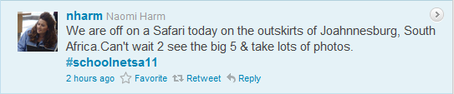
#Schoolnetsa11
Hover curser over tweet 2 see Retweet +Reply +
Notes:
[twitter] Search for #schoolnetsa11 in the dialogue box next to the twitter icon at the top[/twitter]

Slide 8
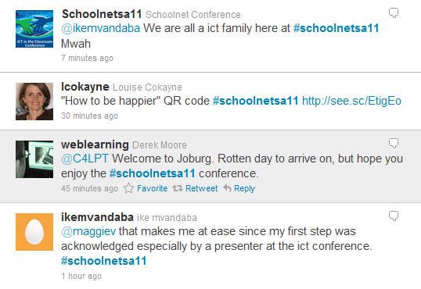
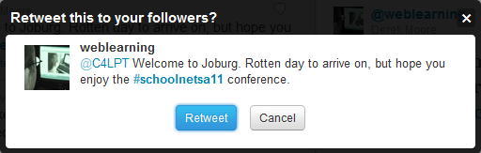
Retweet will pass information along as is
edtechconf
Notes:
[twitter] Hit Retweet if you want to post the entire post to your twitter stream 4 those who follow u [/twitter]

Slide 9


To have discussions, hover and click on Reply
Notes:
[twitter]Hit reply to answer someone or comment back- it will insert their handle already[/twitter]

Slide 10
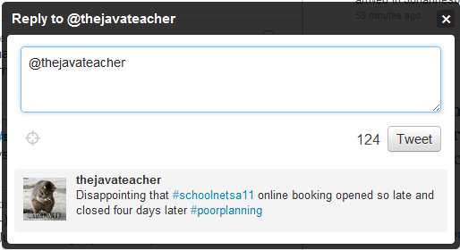
Type your reply and tweet
Sorry about that :-) but we only had limited
space for labs and 1st come… #schoolnetsa11
Notes:
[twitter]Hit reply to answer someone or comment back- it will insert their handle already[/twitter]

Slide 11
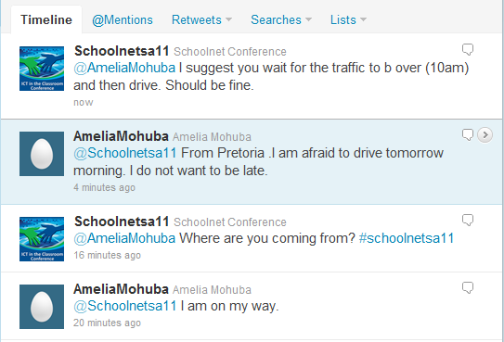
Click Home→Timeline to see tweets of everybody you are following
Notes:
[twitter] to see those who you follow’s tweets, click on Home→timeline[/twitter]

Slide 12
Don’t forget to follow @schoolnetsa11 for updates and news
Notes:
[twitter] to see those who you follow’s tweets, click on Home→timeline[/twitter]

Slide 13
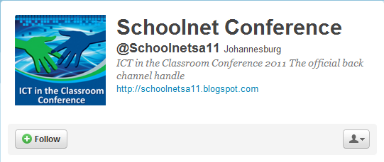
Double click on @schoolnetsa in the conference stream and click Follow
Notes:
[twitter] to see those who you follow’s tweets, click on Home→timeline[/twitter]

Slide 14
So: Ask questions
Answer questions
Share links
Summarise
See you in the stream!!
Notes:
[twitter] Ask questions, answer, share something or summarise the talks! [/twitter]

