Slide 1



Partners
in
LEARNING
Network
Africa
http://africa.partnersinlearningnetwork.com

Slide 2

Partners
in
Network
LEARNING
(Africa)
PiL Network (Africa)
allows you to:
  Create or join communities & discussions
  Find lesson plans, VCT’s, activities, & share your
  own resources.
  Access free tools & learning programs for your
  class and school.
  Collaborate with likeminded colleagues & improve
  education across Africa and globally.

Slide 3

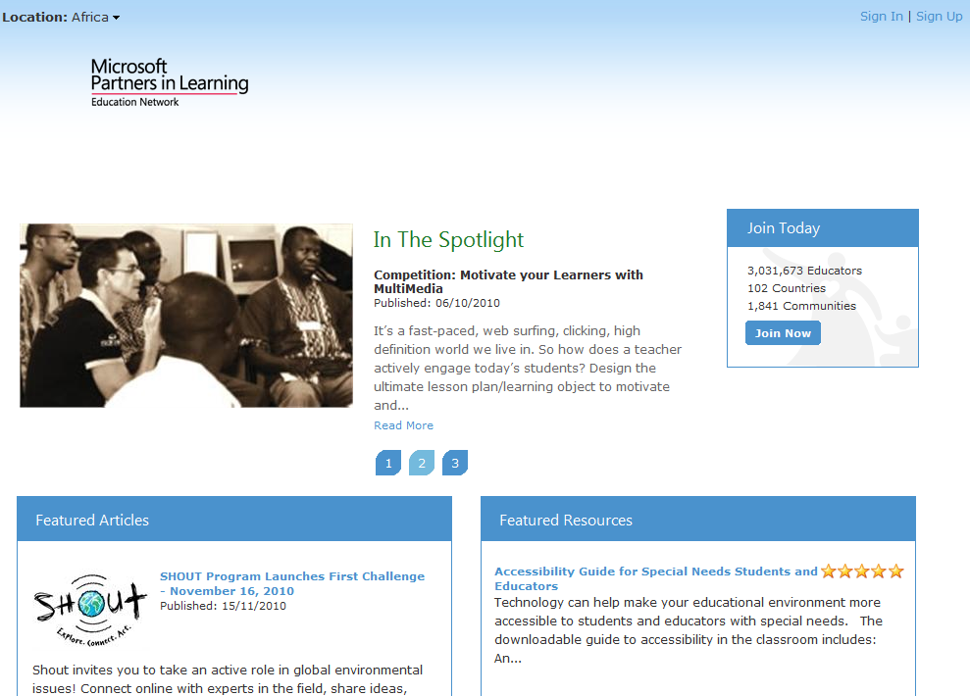
WELCOME
Page
Sign In here
(if already a Member).
New to PiL NetworK? Join the PiL Network here.
Use the
dropdown to
access other PiL Network Sites.
1
2
3
4
In the Spotlight features top 3 featured articles.
3
View description and ratings of 5 latest featured resources.
5
6
Access listing of previous local featured articles

Slide 4


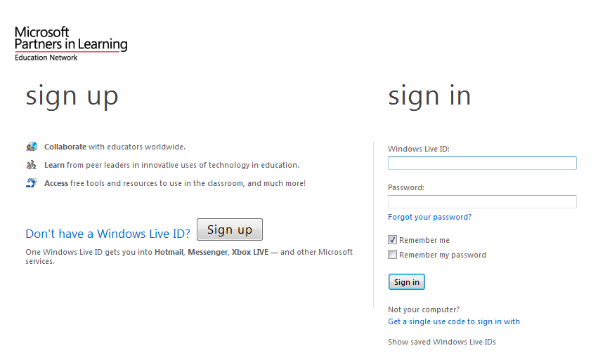
SIGN
In
If already
registered or
if you possess
a LiveID
account, enter
your details and click on the ‘Sign In’ button
Create a new Live ID account by clicking on Sign Up.
2
1
  Did you know: “You can use your LiveID from your Live@Edu
  account to access the Network.”

Slide 5

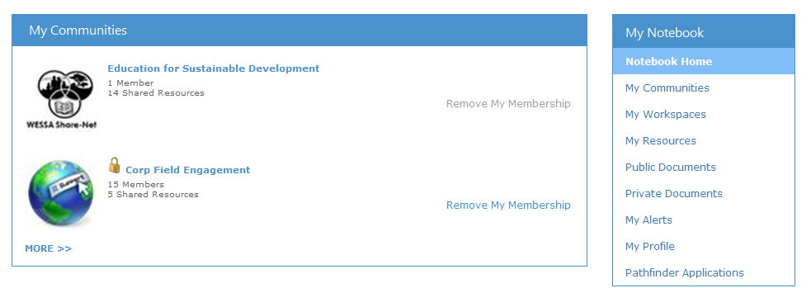
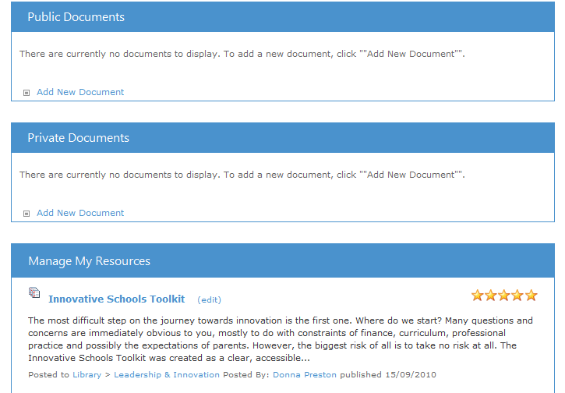
My
NOTEBOOK
“My Notebook” is your personalised homepage. Here you can:
1
Access communities you have created as well as view all other communities of which you are a member.
5
Access any public documents / resources/ VCT’s you uploaded to the Network.
2
Update/ view your personal profile.
Access any private documents uploaded to the Network.
3
4
Upload and manage resources/lesson plans and VCTs to share with the community.

Slide 6
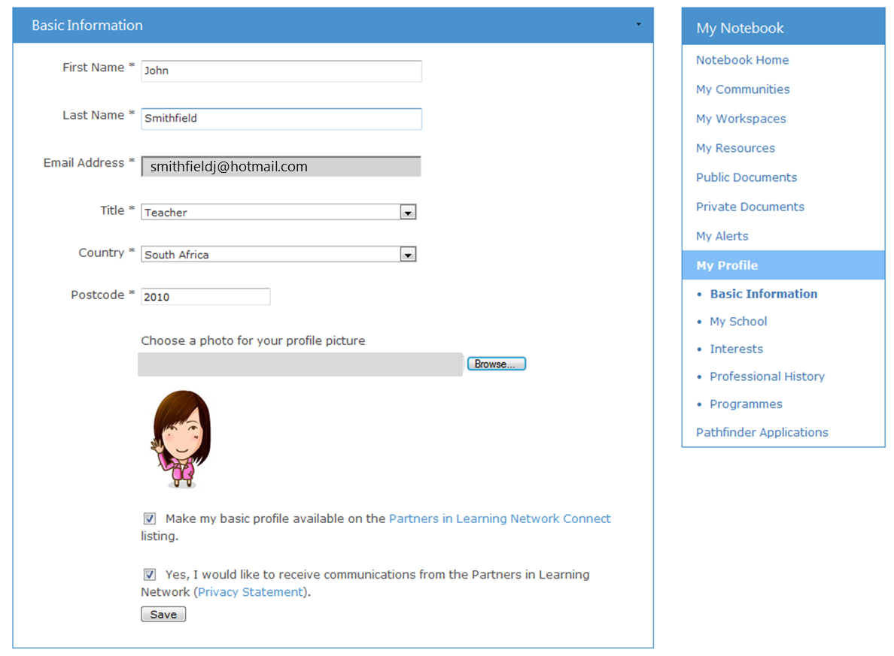

My
PROFILE
Complete all the sections in your Profile page, especially your School details so you can connect with other schools globally.
PiLN Connect - Select this option to make your profile available globally so you connect with other teachers and schools across continents.
1
2

Slide 7
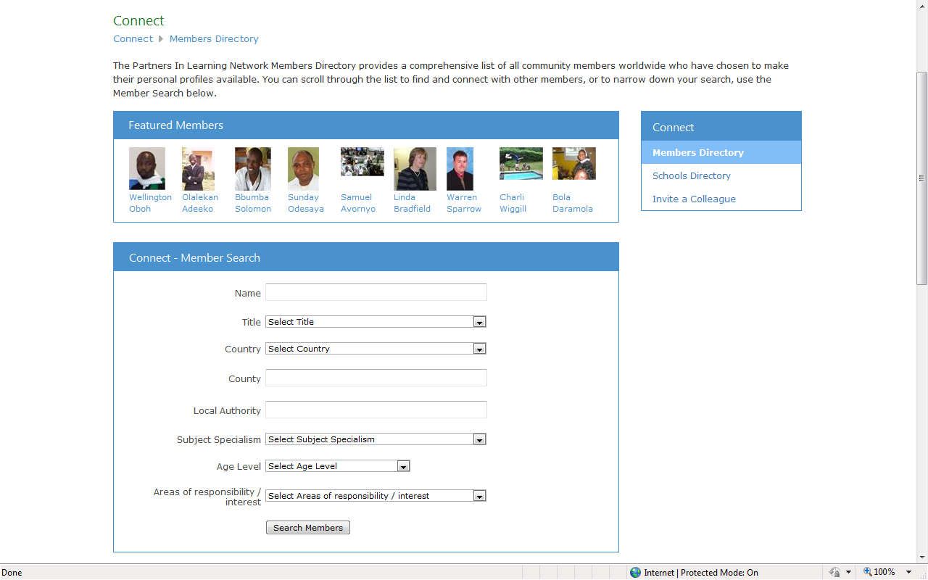
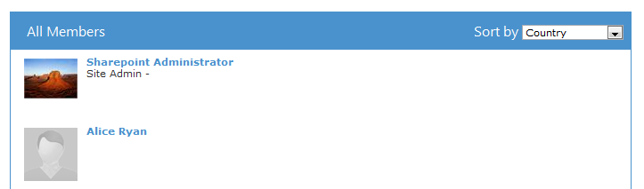
Connect
MEMBERS
View a list of Featured African teachers on the Network. Click on their names to find out more about them or contact them!
1
4
5
2
Access directory of schools listed on the network worldwide.
Make use of the Member Search to search for a fellow teacher in your subject area or expand your search to connect with peers across countries and collaborate on exciting projects.
Share the Knowledge- Invite a Colleague to join the Network!
3
View full list of all members listed on the Network worldwide.

Slide 8
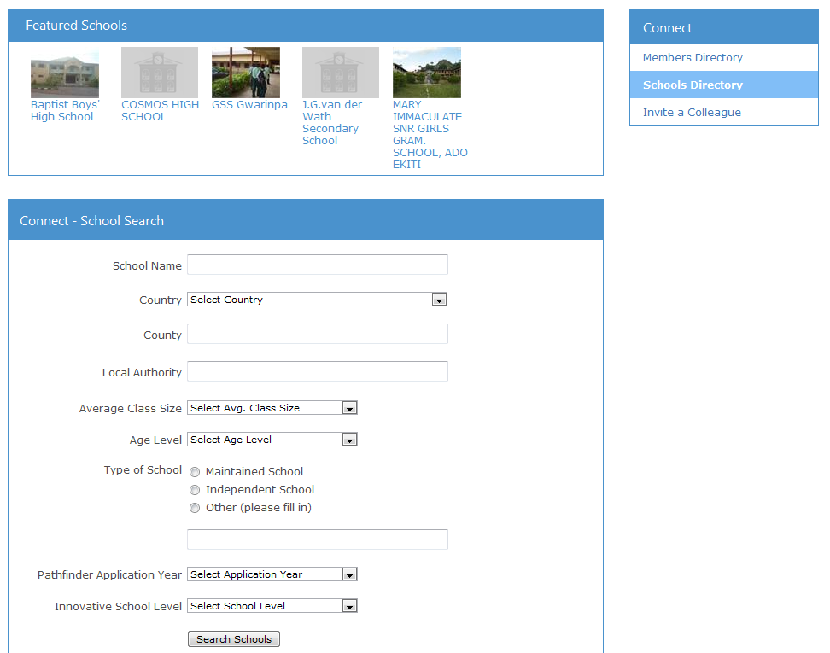
Connect
SCHOOLS
View a list of Featured African Schools on the Network. Click on the school name to find out more about the school or connect with members from that school!
1
3
Share the Knowledge- Invite a Colleague to join the Network!
2
Make use of the School Search to search for schools in your own region or across countries.

Slide 9
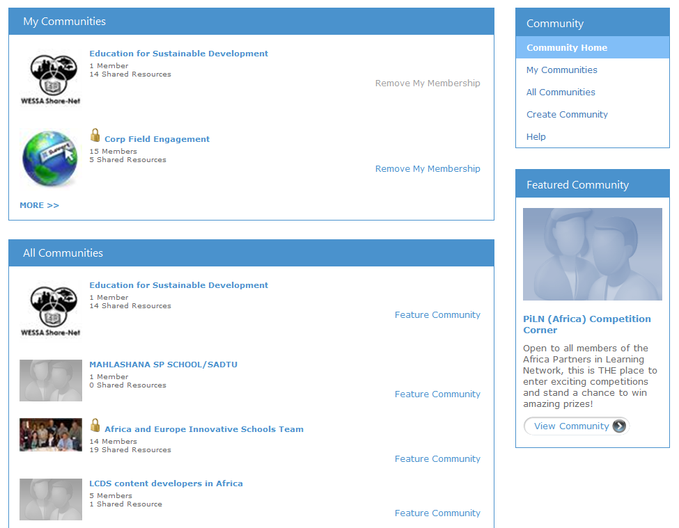
Communities
Access communities to which you hold ownership or membership.
1
Why not Create your own Community? Passionate about a topic? Then start your own community and share resources and ideas and encourage your peers to join in!
3
2
View a complete list of communities available on the Network.

Slide 10
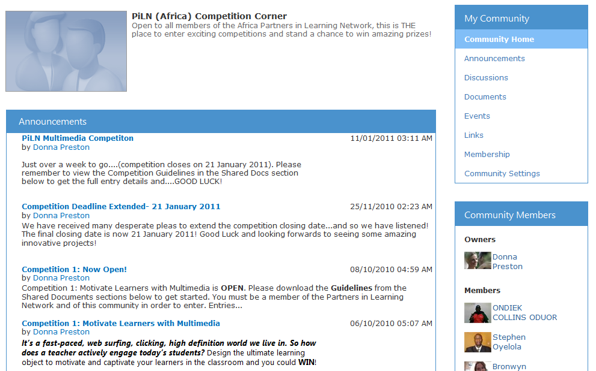
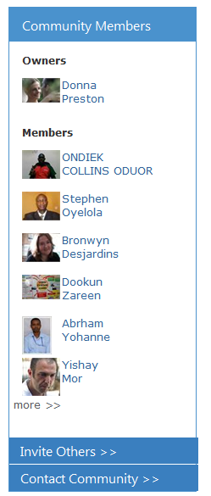
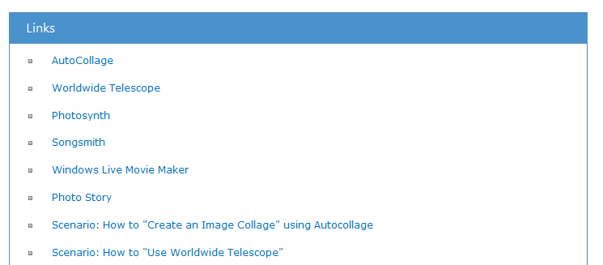
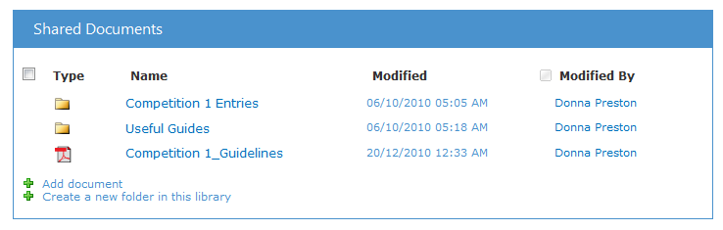
Communities
Contribute
&
COLLABORATE
Leader and Member list
Announcements
Discussions
Events
Links
Shared documents
Photo Galleries

Slide 11

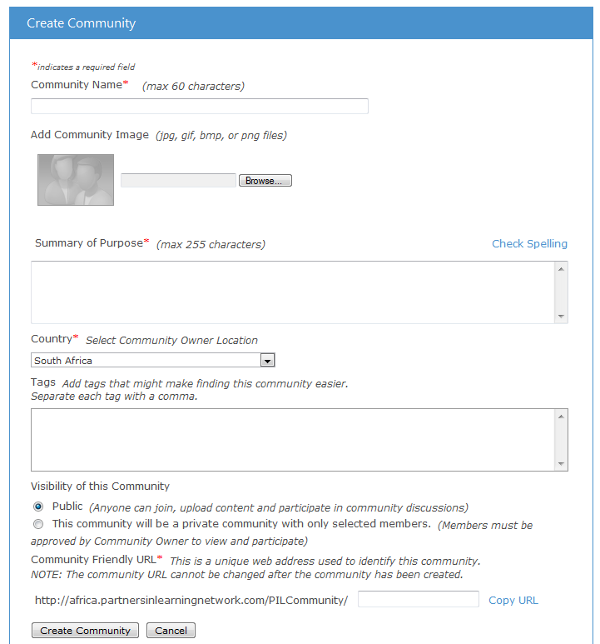
Create
a
COMMUNITY
Give your
community a name.
1
Add a suitable
image or logo
that represents
your community.
2
Summarize your community’s purpose.
3
Add tags / keywords to help describe your community and make it easier for others to find.
Select the
country of origin.
4
5
6
Then click on
Create Community…
Select whether you want your community to be public or private.
7
New communities are moderated, so you will need to wait to get approval.
But once it has been approved, you can start sharing ideas and enlisting recruits!

Slide 12
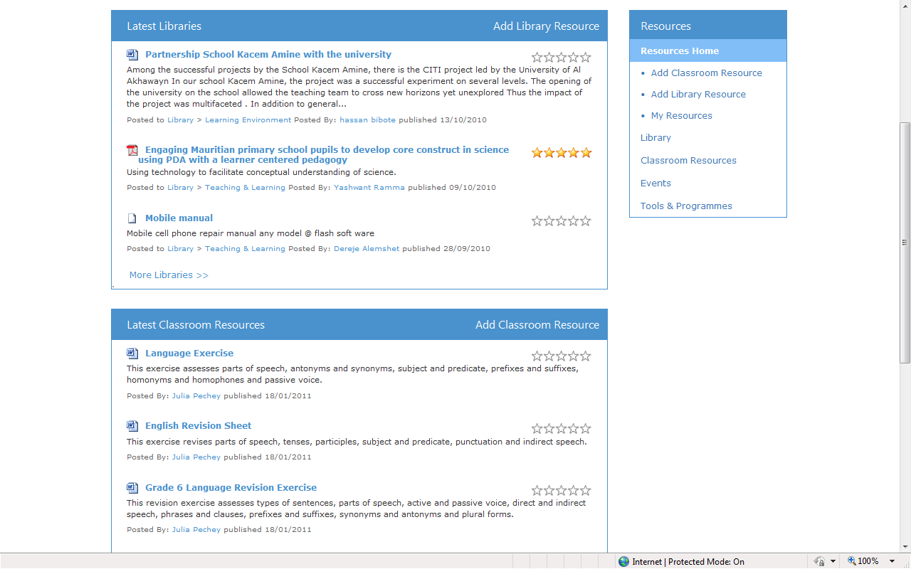
Resources
Add a Classroom Resource or Library Resource to the Network.
1
Access the latest Library Resources, organised according to categories
such as:
  Teaching & Learning
  Leadership & Innovation
  Professional Development
  Learning Environments.
3
4
5
View and Add Events to the Network.
2
Access the latest Classroom Resources which include exemplary uses of integrating ICT into teaching.
Access list of Tools and Programs highlighted on the Network.

Slide 13

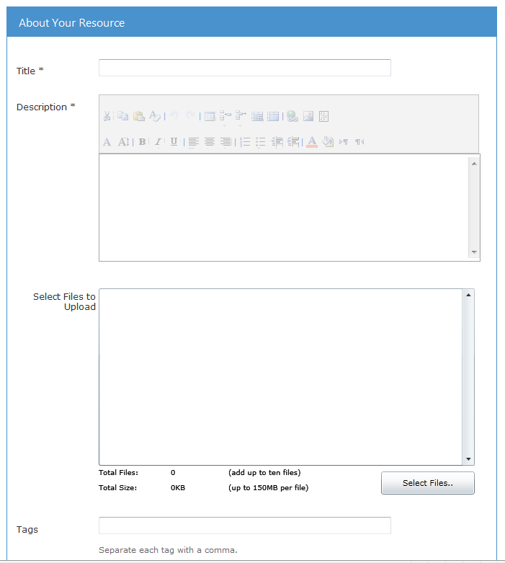
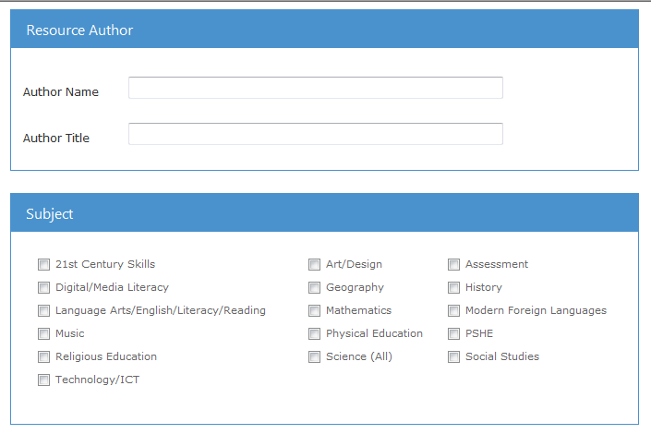
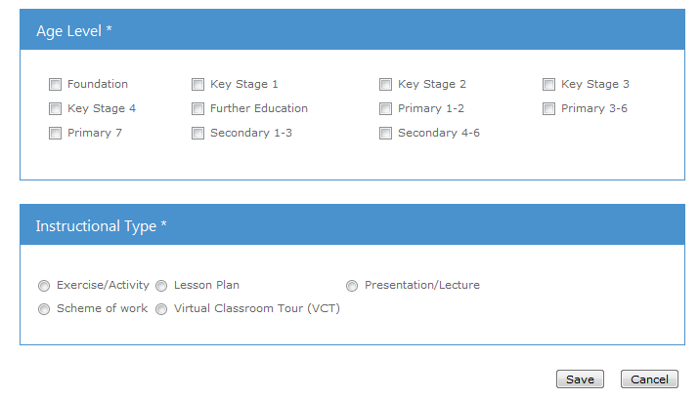
Add
RESOURCE
Classroom
Select your file (if your upload consists of several files, zip them first) to upload.
To upload a
resource, simply follow the
following steps:
1
Supply relevant tags / keywords for your resource
2
Add name of the author / creator of the resource (if not your own) and their title.
Give your Resource a Title.
Provide a Description.
Specify target Age Level of the resource
Select relevant Subject options.
3
Click on ‘Save’.
Specify Instructional type.
5
7
6
4
8
9

Slide 14
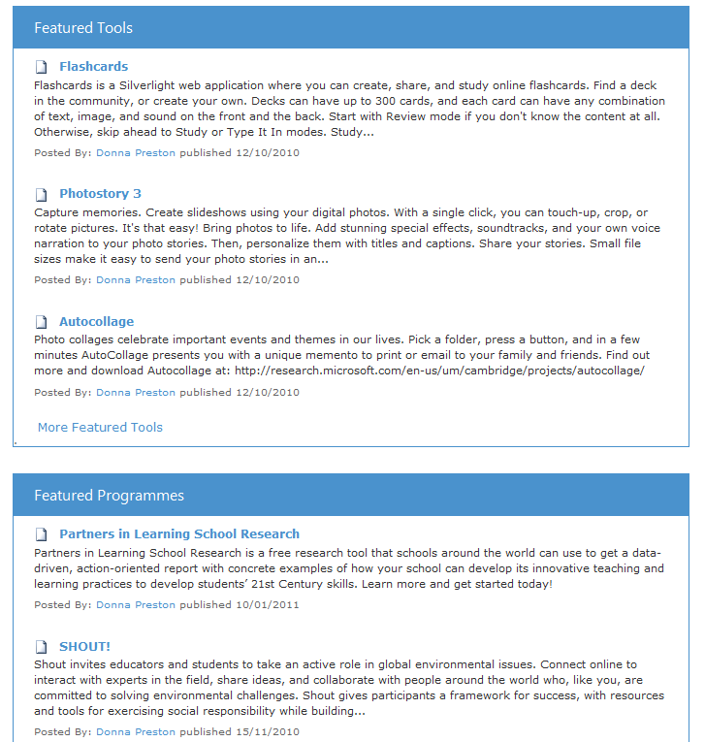
Tools
&
PROGRAMS
This page provides all members with access to free tools, programs and solutions that enable lifelong learners to realize their full potential.

Slide 15


Find
US
FaceBook!
on
Did you know:
The Partners in Learning Network (Africa)
is now on FaceBook…?
Join the Partners in Learning Network (Africa) fan page and you will:
Receive alerts about the latest resource offerings on PiLN including amazing Virtual Classroom
Tours created by Innovative Teachers from across Africa.
Be the first to know about exciting upcoming competitions.
Find out about the latest and greatest free tools and programmes for you and your school.
Be alerted about exiting new communities on the Partners in Learning Network.
Help grow the community of teachers who value innovative uses of information and
communication technology that improves learning outcomes.
Help spread the word. Share the link with all your friends and colleagues. “Like” the Partners in Learning Network fan page on FaceBook today!
Visit: http://www.facebook.com/pages/Partners-in-Learning-Network-Africa/139543289420280?ref=sgm

Slide 16

Africa
Partners
in
LEARNING
Network
http://africa.partnersinlearningnetwork.com
For more information
contact:
Angela Schaerer:
v-angels@microsoft.com
Victor Ngobeni:
v-vingob@microsoft.com

