Slide 1
USING THE XBOX KINECT IN FOUNDATION PHASE ENGLISH LANGUAGE ACQUISITION
Karen Kirsten, Janet Thomson, Peter de Lisle

Slide 2
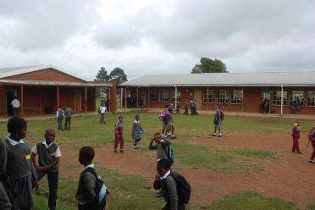
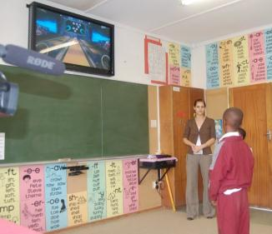
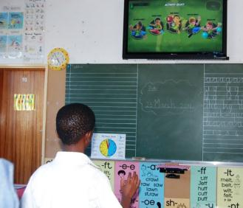
When, Where, What
1 ½ months after international launch of Kinect
Lakeside Primary – Vryheid
Basic Classroom setup

Slide 3
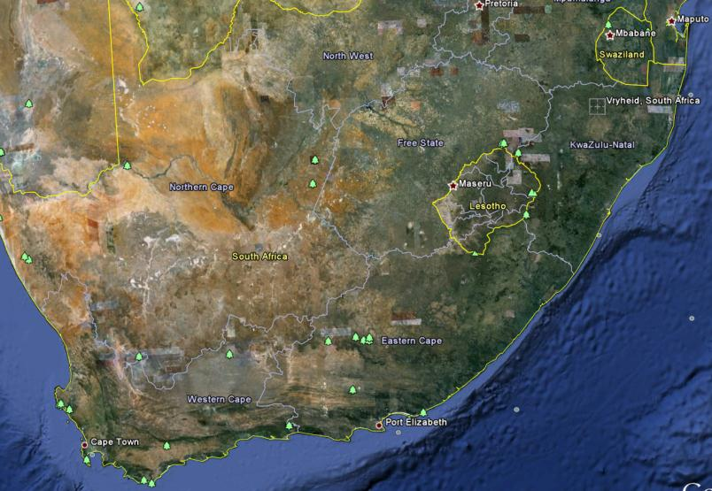
Where is Vryheid?

Slide 4
I: The Problem, & Principles for finding a Solution

Slide 5
English as Language of Learning
Learning through English is difficult.
family illiteracy
low exposure to English
gap between learners’ language ability and the language demands of the curriculum
Teachers not geared towards using a language-supportive pedagogy
(Clegg, Ogange, & Rodseth, 2003)

Slide 6
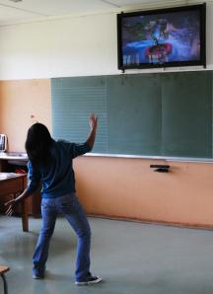
Features of Language-supportive Pedagogy
Use tasks which provide language support
Use teacher-talk to present concepts
Vary the form of classroom interaction
  teacher-centred, group, pairs, individual work
Use visuals to support understanding
Teach learning strategies for learning in a L2
Encourage learners to use their L1 under specific circumstances
(Clegg, Ogange, & Rodseth, 2003)

Slide 7

L2 Literacy in English
“Literacy programs that provide instructional support of oral language development in English, aligned with high-quality literacy instruction are the most successful.”
“Students instructed in their native language as well as in English perform better.”
(August, 2006)

Slide 8

Oral Activities
talk (in small groups)
speak using guidance from visual
information gap activities
card sorting
speak, record and listen
guidance from words/phrases
guidance from connectors
use a speaking frame
speak using a model (e.g. sentence pattern)
listen and repeat a sound/structure

Slide 9

Pedagogical approach for the Acquisition of Literacy in English
The key objective in learning language is communication.
Teachers need to focus primarily on Oral proficiency
Create an environment which supports and encourages learners to experiment with speaking in English and developing basic literacy skills.
In all activities, a language-sensitive approach must be used.
Work across the curriculum, not just in “English” lessons.

Slide 10
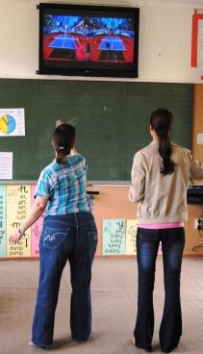
Educational Philosophy
Learner-centred
Exploration and discovery
Learners create meaning, teachers facilitate
Differentiated
  various learning styles, not just listening
cognitive development
  thinking, problem solving, fantasy and creativity
Active: physically, cognitively and emotionally
  activities that are fun, challenging
  relevant to the learners lives in the real world
Motivation
  enthusiasm and involvement
  activities which are naturally engaging.

Slide 11

Games in Education
Computer as Teacher
  “Drill & Kill”
Computer as Creator of Context
  An immersive experience
  Simulates real life
  Eg Guitar Hero, WWIEF 2009 winner
  Eg Myst, creative writing

Slide 12
II: Gesture-Based Computing

Slide 13
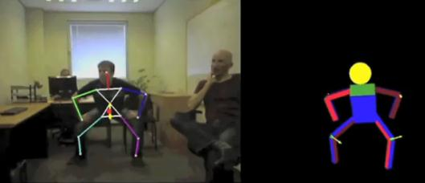
Horizon Report
2-3 year horizon:
“Game-based learning has grown in recent years as research continues to demonstrate its effectiveness for learning.”
4-5 year horizon:
“Gesture-based computing moves the control of computers from a mouse and keyboard to the motions of the body via new input devices.”

Slide 14
Development of Kinect
Microsoft Video

Slide 15
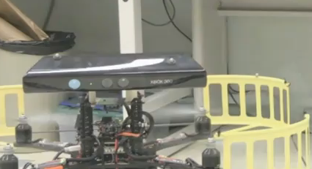
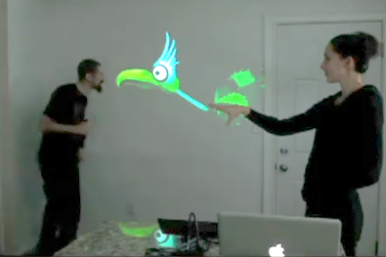
Exciting Kinect Hacks
Flying robot
Virtual creatures

Slide 16
Principles for using Xbox Kinect
the games should not be expected to teach anything on their own;
enable learners to move freely and energetically;
this is an English Second Language learning situation;
literacy is being taught at the same time in English
English is the language of learning across the curriculum;
create opportunities to develop oral skills in English, using a variety of activities before, during and after the games;
develop oral, listening, reading and writing activities based on the initial oral activities;
use a language-sensitive pedagogy.

Slide 17

Some Ideas for use of Kinect
Reward
Direction words
Communication gap:
Expand on a game, eg predict what will happen.
Create avatars;
  use for body parts, colours, etc.
Role play
Numeracy
Overview
Maps
Self-management
Emotional intelligence
Environmental awareness

Slide 18
III: What Happened in Practice?

Slide 19
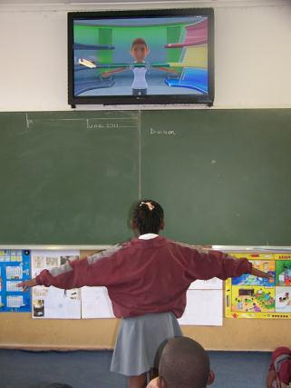
Remedial
Easy to spot learners who had not yet mastered some of the aspects of School Readiness:
  Eg Spatial Orientation
  Dominance
  Midline Crossing

Slide 20
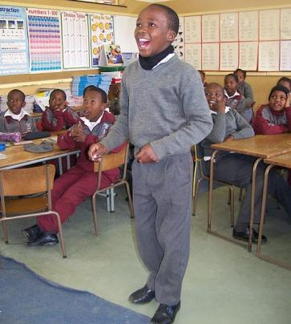

Opportunities to experience Success
Noxolo’s story of her first day in grade two.
Luanda in grade 3.

Slide 21
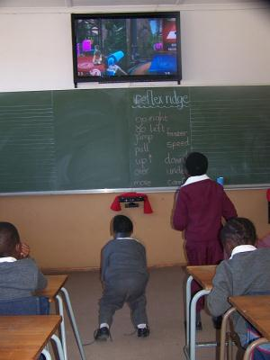
Extension
Provide a platform for vocab extension.
Kids don’t just see and hear the words, they do them
  e.g kick, jump etc.
  gr 1 – “wrong way” and “How many can be dominant at a time?”
Explore games and levels that teachers are unaware of.
A chance to experience and acquire knowledge they wouldn’t ordinarily experience
  e.g throw javelin and shotput in Kinect Sports
  river rafting in Kinect Adventures.

Slide 22

Confidence Boost
Teachers report increase of confidence levels
  coax a shy learner to play, you see another side to them..

Slide 23
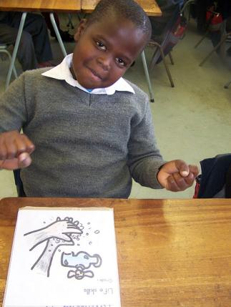
Promotion of Oral Work
Formal Oral Composition not as daunting a task as before.
  learners are more relaxed and eager to speak during and immediately after a game.
  use games as an introduction to discussions on other topics.

Slide 24
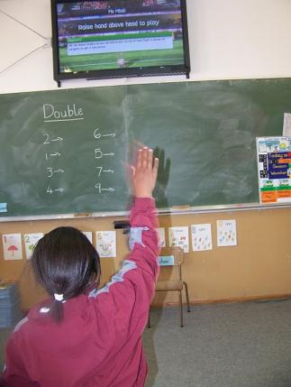
Maths
Easy to integrate the games into their lesson plans.
Many different aspects of maths correlate with games.

Slide 25
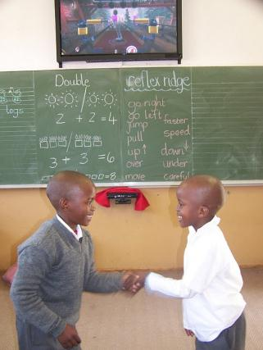
Life Skills/Relationships
Coincidental skill acquisition
  sharing, waiting your turn, controlling emotions, obeying rules, winning, losing, good sportsmanship, etc
Group work is easier
  Learners are able to concentrate on a task while a group plays.
Teachers discover things about their learners during free play
  e.g game preferences, leadership skills.

Slide 26
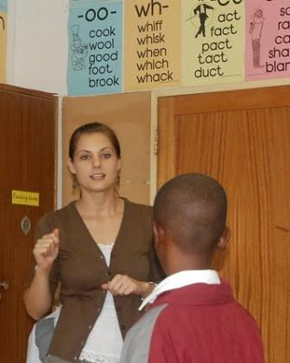
Promotes Active Listening
Learners had become “lazy listeners”.
Game instructions are given once and a response is expected.
Learners have to pay attention and listen as there are no repeats.
Talk about JvR demo.

Slide 27
Classroom Management & Kinect:
How to
Planning is key.
Establish Kinect rules with your kids.
Know how to get to the game you want to use.
Ensure you are familiar with the game and can predict possible outcomes.
Time allocation: how many learners?
  When whole class, go for the shorter (40 sec) options.
Small group: select a game that can be played with the volume low or off.
Select group leader, scribe, etc, before you start the game.
Select the playing two at a time option to save time.

