Slide 1
Project Overview
Learning Areas
English
Levels
High School (15 years old)
Objectives
1. Appreciate and understand the language of William Shakespeare by paraphrasing; 2. Use the internet to find help in understanding archaic words and key lines used in one of Shakespeare’s plays; 3. Practice creativity and resourcefulness in localizing a play of William Shakespeare; 4. Act out and film the revised script of the play; 5. Show understanding of local customs and traditions by accurately infusing them in the play; 6. Show thorough understanding and appreciation by writing a composition containing one’s realizations and analysis of the play.
Description
Tradition and Technology blend to aid students understand and appreciate a Shakespearean play. In phase 1, students modernize a Shakespearean play’s language making use of the internet to find help in understanding the original script; they then localize the setting to reflect either the modern local community or ancient community customs and traditions. In phase 2, students film the play and edit it using Windows Movie Maker 2. In phase 3, students put into writing their personal realizations and analysis of the play.
Software
Microsoft Internet Explorer, Microsoft Word, Windows Movie Maker 2
Keywords
Shakespeare, Localization, Digitization
Authors
Warren Ambat, Baguio City National High School, Philippines
Documents
Notes:
This Virtual Classroom Tour template has been provided so you can develop your own Virtual Classroom Tours. Use the template to record a special learning project that you have found particularly successful in your classroom. Then share the project with other teachers in your school, district or beyond.
Here’s how:
Follow the prompts on each slide and in the embedded Word documents, in this PowerPoint document, to insert your project information. When you have finished inputting all of the project information that is requested, delete the prompts. Select each one and press the Delete key.
Note: To enter the title of your Virtual Classroom Tour you must select View, Slide Master, and enter it on the slide master. You might also wish to insert a picture illustrating the subject of your Classroom Learning Resource. Then click Close Master View. This will cause the title and picture to appear on each of the slides.
From the Office Button menu choose Save As… and save the document as a PowerPoint Presentation . You can then distribute the Virtual Classroom Tour.

Slide 2
Teacher Planning and Management
Click the document below to help you understand the context of this exemplary learning project:
Background & Planning: A picture of the origin and objectives of the learning project, including the manner in which the project was planned and managed.
Technology Training
Pages from Internet Classroom
www.nicenet.org
Documents
Notes:
Open the Word documents at the bottom of each slide by double clicking the icons. Follow the prompts [in the yellow boxes] for inserting information about your learning project.

Slide 3
Teaching Resources
Click the documents below to view the teaching resources used in the teaching of this learning project:
Student Project Overview: An overview of required tasks.
Implementation Procedures: Download teaching resources in Class Server format.
Documents
Notes:
On this slide, embed the student handouts and the resources created for this project. Some examples are a student project overview, Internet and other resources, directions for art projects, or instructions to students for peer editing of projects. To embed the resources, follow these steps:
Have the resource document available.
From the Insert menu choose Object.
Select Create from File… and click Browse….
Find the file you want to include and click OK.
Select Display as icon and click Change Icon… and add a suitable caption.
Click OK to add the caption and click OK to embed the file.
Position the document icon at the bottom of the slide. You can go to View, Grid and Guides, and click Display Grid on Screen for a grid on which to line up your icons.
Remember to activate an Object action from the Insert banner.

Slide 4
Student Work Samples and Teacher Reflection
Click the documents below to view student work samples and reflections from the teacher.
Student Work Samples: Examples of student work generated through participation in this learning project.
Teacher Reflection: Thoughts and reflective comment from the teacher including advice for future implementation.
Student Work Samples
The famous balcony scene is set in a traditional Cordilleran village.
This scene, when Claudio shames hero on the day of their wedding, showcases a native Cordilleran ritual during weddings.
Driven by guilt, Lady Macbeth turns insane and kills herself in this modernized comedy version of Macbeth, one of Shakespeare’s well known tragedy.
Documents

Slide 5
Assessment and Standards
Click the documents below to see the assessment rubrics and standards cover in this learning project:
Assessment Rubrics: Examples of assessment rubrics provided to students showing how the project was assessed.
Mapping the Standards: Mapping this project’s learning objectives against curriculum standards.
Documents
Notes:
Add any assessment materials you developed for the project to this slide.
Have the resource document available.
From the Insert menu choose Object.
Select Create from File… and click Browse….
Find the file you want to include and click OK.
Select Display as icon and click Change Icon… and add a suitable caption.
Click OK to add the caption and click OK to embed the file.
Position the document icon at the bottom of the slide. You can go to View, Grid and Guides, and click Display Grid on Screen for a grid on which to line up your icons.
Remember to activate an Object action from the Insert banner.
To include the Standards targeted through your learning project, open the Mapping the Standards document and then add your own standards at the bottom of the document. Links are included to help you search for local curriculum and technology standards.

Slide 6
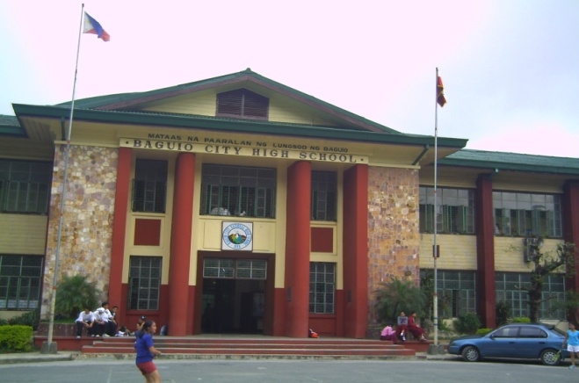
Teacher and School Information
Baguio City National High School is the largest public secondary school in Baguio City, Philippines. It caters to the educational needs of the Igorots, the indigenous inhabitants of the Cordillera highlands and the lowlanders.
Warren Ambat is an English teacher whose lack of formal computer literacy education has fueled his unrelenting interest in technology and its use in education. He has been a teacher for 11 years.
Notes:
On this slide you should add pictures and information about your school and yourself.

